Slide 1

Mudd 90s X Talk
Elecia White ‘96
Logical Elegance, Inc.
Embedded.fm
Notes:
(Harvey Mudd is known for its Interdisciplinary approach with
a concentration in humanities.
I wanted to see how many different disciplines
I could fit into a short talk. )

Slide 2
Snails, Paper, and Programming
A Computational Approach to Mollusc Morphology in Origami
Notes:
These slides are available,
as are origami patterns.
You must provide your own paper.
And, if working with live snails, your own snails.

Slide 3
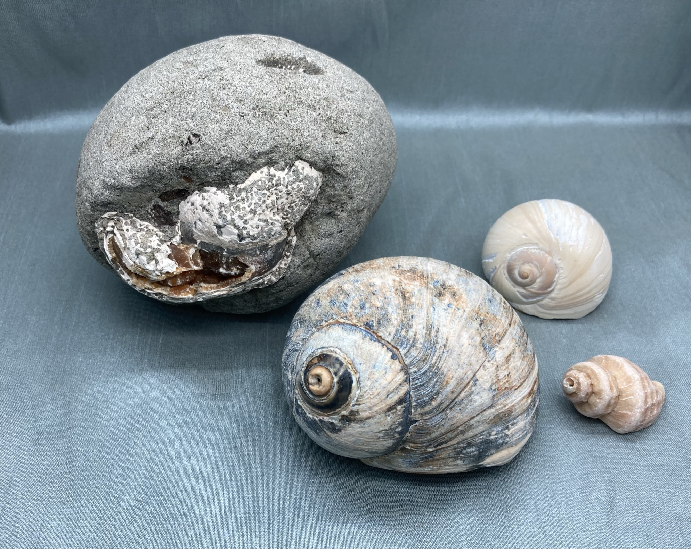
Snails
Ok, all molluscs with shells.
But not cephalopods.
Notes:
(Show shells live)
Actually… it is just the shells
And I need to start with some terms.
Planispiral (curves in on itself like a nautilus)
means it is in plane
Turbinate (curves off to the side like a snail, conical)
means it has a turban
Revolutions are what they sound like,
revolutions around the center of the shell.
Whorls are the physical representation of revolutions
Protoconch (tip, apex, first shell of the baby snail)
Body whorl is the last, largest whorl
Aperture – the opening to the outside
Enough vocab, why are shells interesting?
***
See http://www.petersseashells.com/morphology.html
Or
https://en.wikipedia.org/wiki/Gastropod_shell
If you aren’t getting the demo
***
Septa (interior lines between whorls)…
these are wholly internal though they can appear in the origami

Slide 4
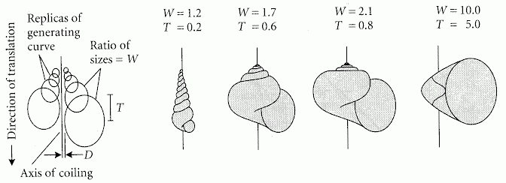
Computer as Aid in Describing Form in Gastropod Shells Raup, 1962
W: size ratio of successive generating curves
D: distance of the generating curve from the axis,
T: proportion of the height of one generating curve that is covered by each subsequent turn.
Notes:
Biologists need a way to describe shells
Mainly so they don’t name one after their kid
Only to find it was already described by someone else.
David Raup provided a way…
The first idea here is the generating curve,
those circles represent the shape the whorl opens to,
the aperture.
I’m not going to read what the parameters means,
the two that you need to know are W which is about how fast the whorls get bigger,
and T which is how much whorls get covered as the shell grows.
So going back to our terms, planispiral,
like a nautilus that curves in on itself,
has a large T
Where turbinate or conical shells have a lower T,
allowing them to have pointy ends.
And check out that paper name… computers in 1962.
Imagine how many punchcards this paleontologist dealt with.

Slide 5
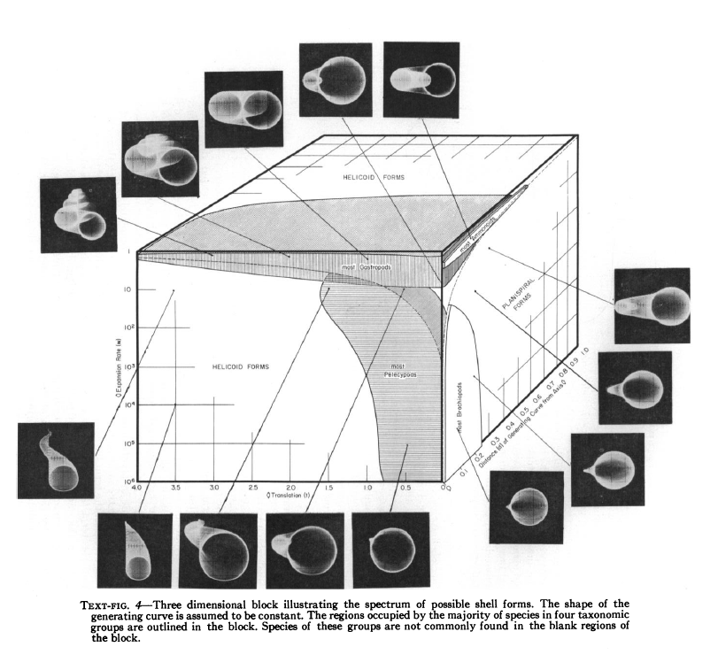
Geometric Analysis of Shell Coiling
Raup, 1966
Notes:
And Raup went even further,
graphing fossil shells
and how they worked with his description method
It shows that nature has tried
many of the options in the parameter space.
I could go on about how nifty this is but…

Slide 6
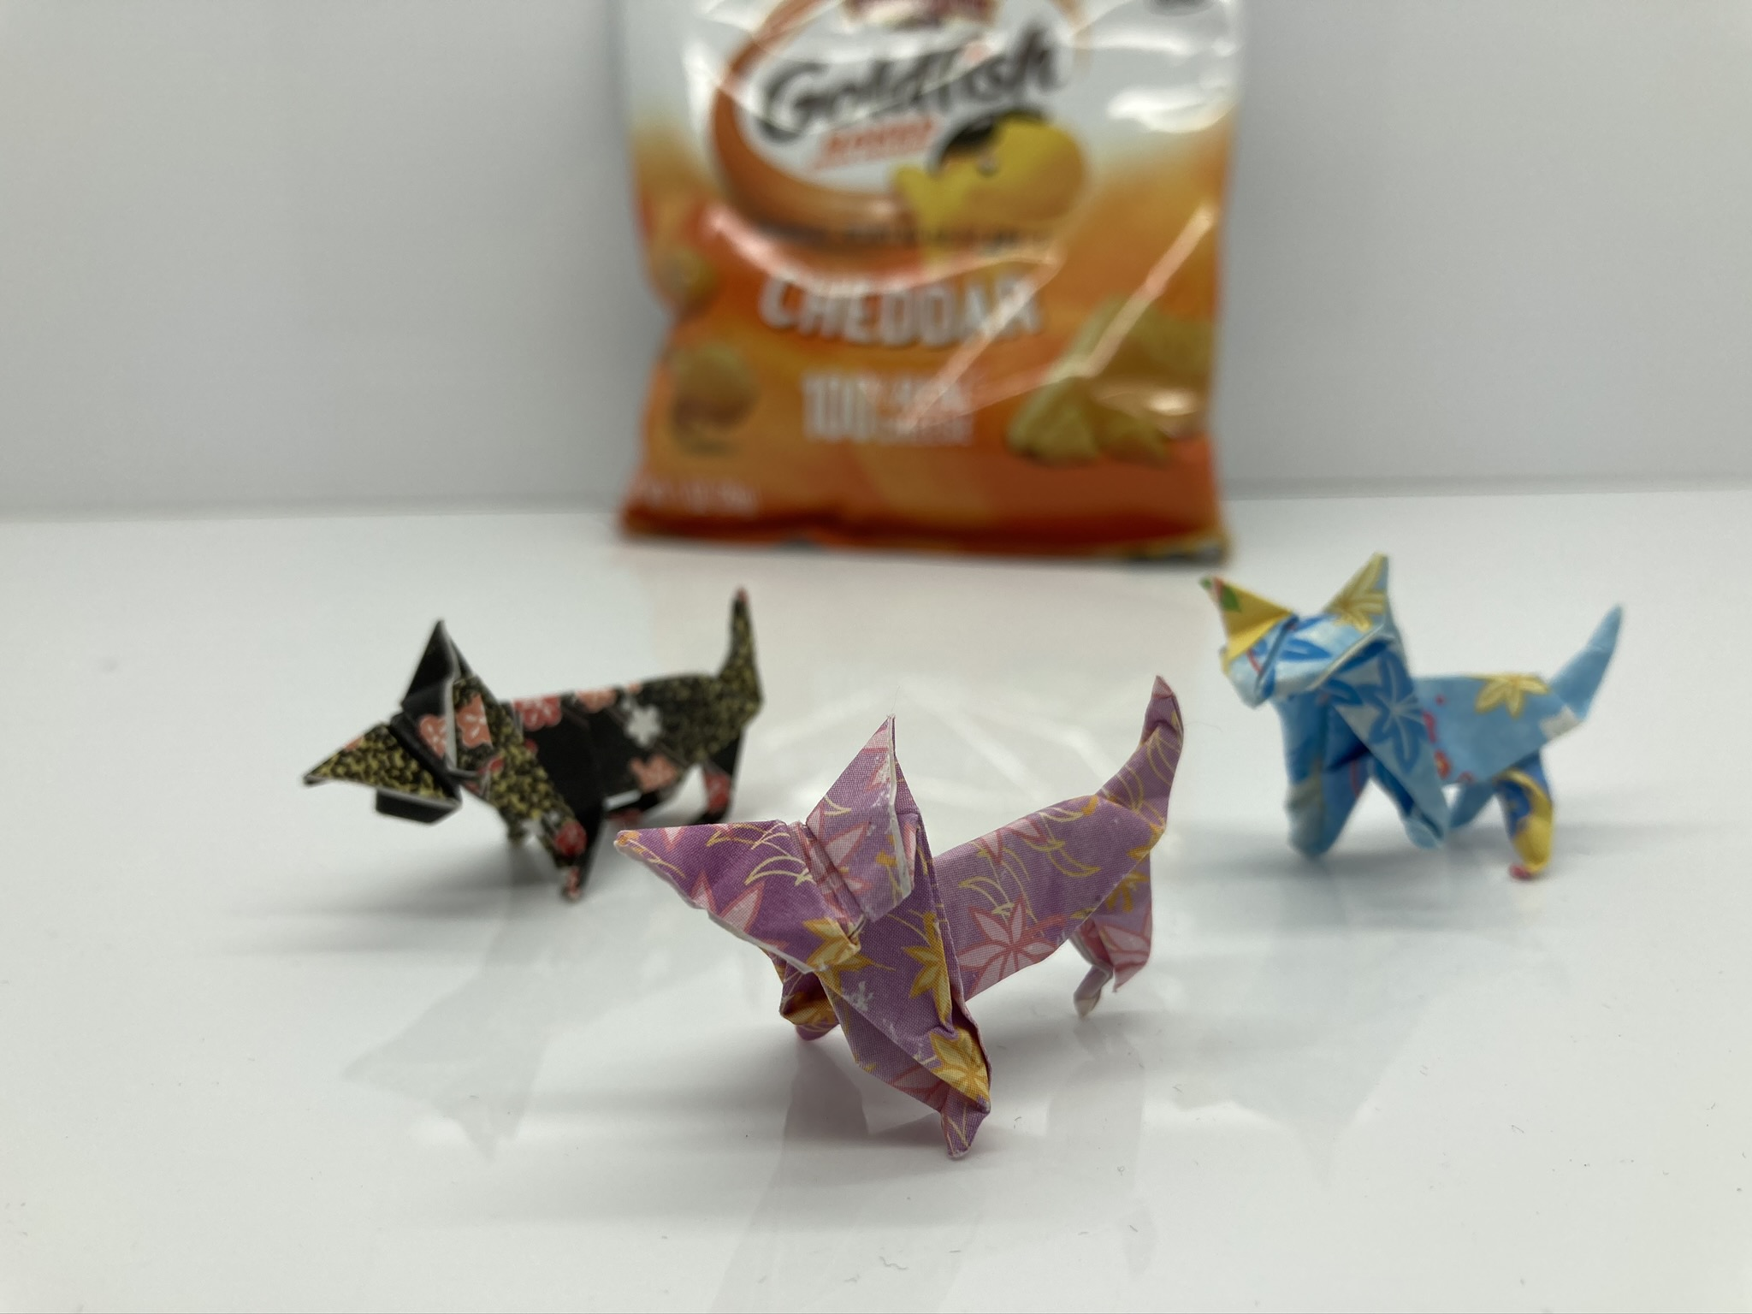
Paper
It started with cats.
As usual.
Notes:
Moving on to paper.
I liked origami but it wasn’t an obsession
Until about two years ago
when I needed to fold a really good origami cat
so I could
add an electronic purring mechanism.
I folded hundreds of cats
I started to understand that
origami isn’t about
successfully folding a 57-step dragon once
but folding the dragon over and over
until you understand it.
A lot like calculus.

Slide 7
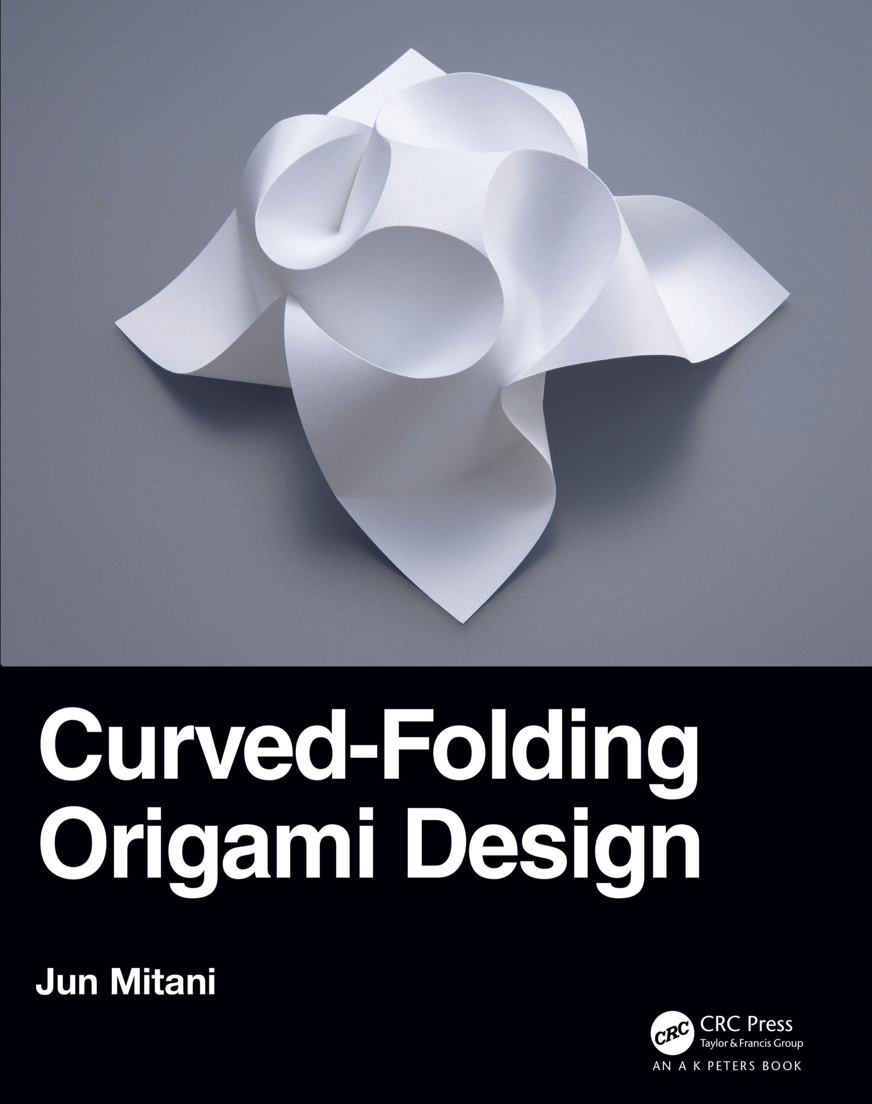
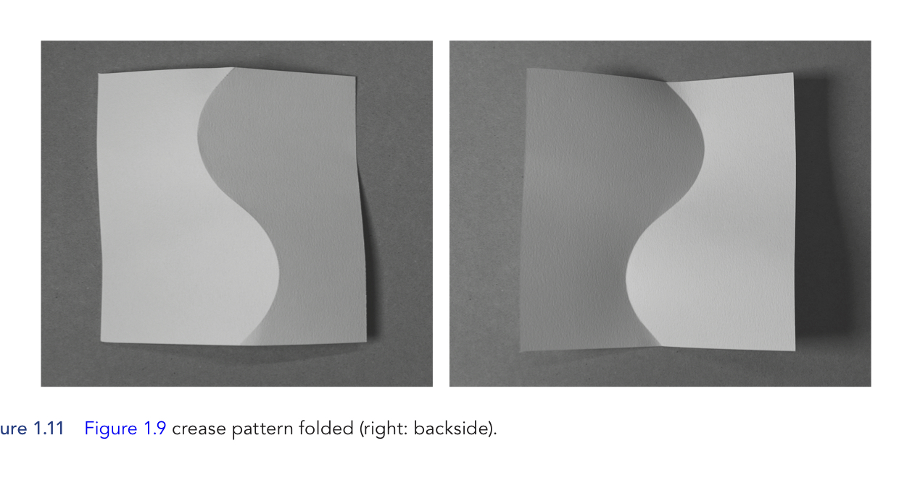
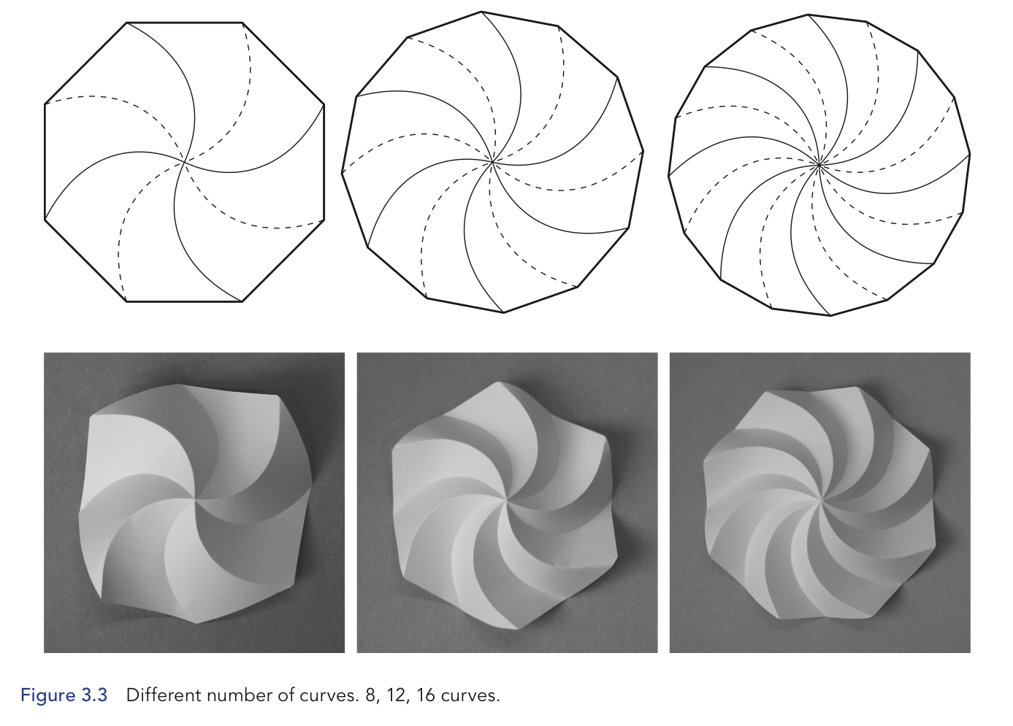
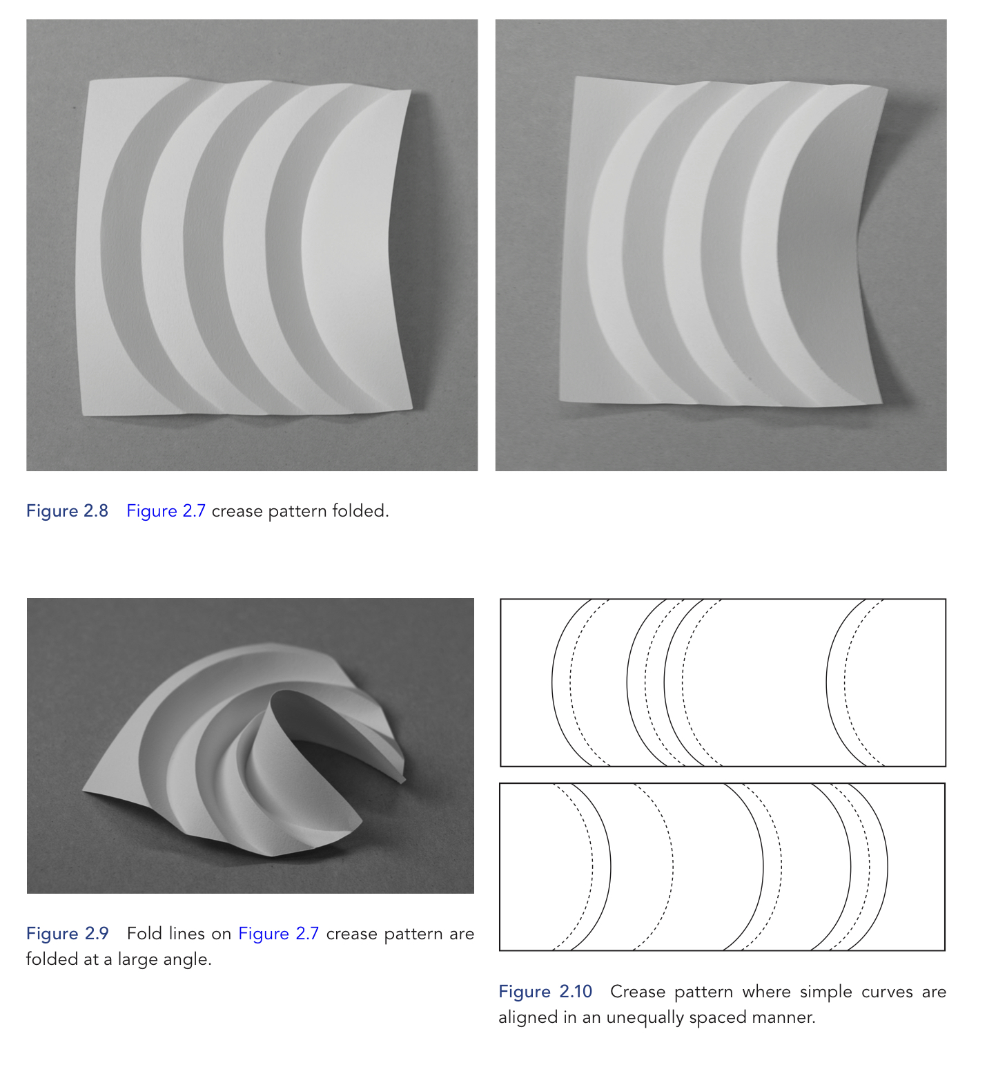
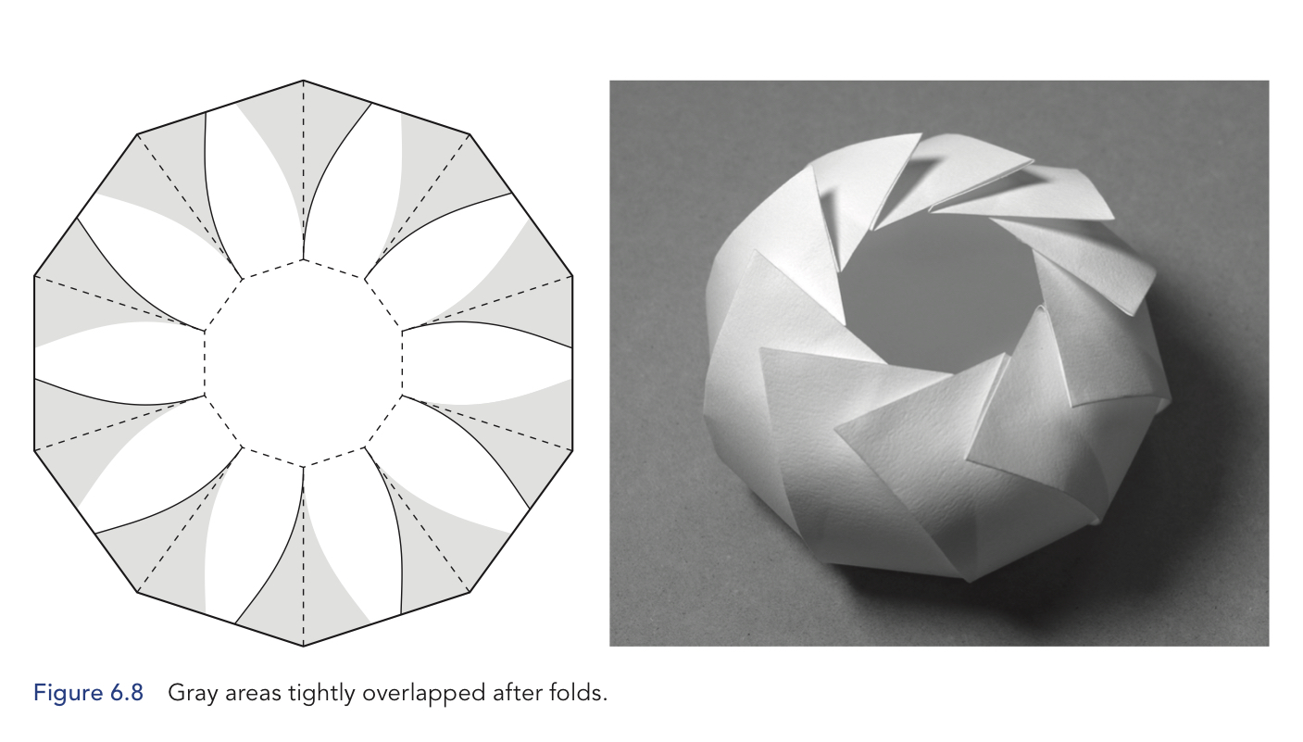
Origami Curves
Notes:
Somewhere in there, I found curved crease origami.
The results are so otherworldly and beautiful.
And always three dimensional.
Computer Science hero David Huffman (of Huffman codes!) was big into curved origami.
The curves have to be precise so
The patterns tend to be generated via computer.
You have to
Prescore the paper
or you can’t have a sharp curved crease.
I found thicker paper, like cardstock, is easier to prescore.
I initially did prescoring by
printing out patterns
and then pressing hard
with a ballpoint pen to get
the groove, the score into the paper
Eventually I got a Cricut, a machine that does that for me.

Slide 8
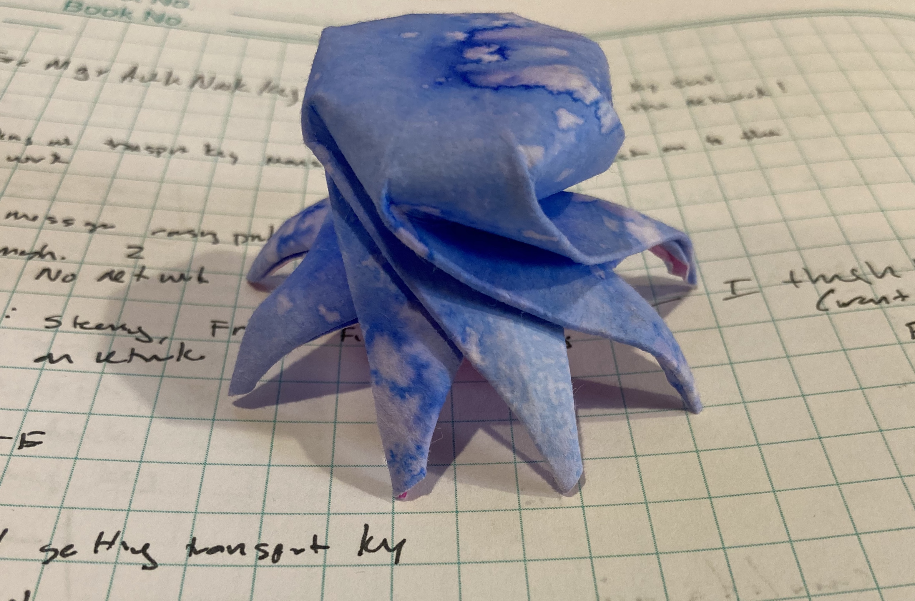
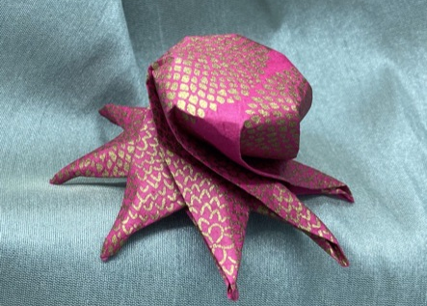
My Curved Crease Octopus
I know, I said no cephalopods.
Notes:
By this point,
I was looking beyond folding what other people did
And thinking about designing my own patterns.
This octopus pattern isn’t too difficult to fold…
I don’t think. I mean other people have successfully done it
so I think it is ok.
But then I wanted an origami aquarium…
And my husband Chris gave me a book as a present.
***
I got a book about folding sea creatures so
I could make an origami aquarium.
One of the creatures was a nautilus and
I couldn’t fold it.
Step 22 just killed me.
When I noticed a failed curved crease bowl
looked like a shell
after I accidentally cut it in half.
I tried to make a shell pattern
and it worked… sort of.
No one else could fold it
because it was 85% made of my determination of
“this is going to look like a shell, dang it”
Happily, my husband Chris gave me a book as a present.

Slide 9
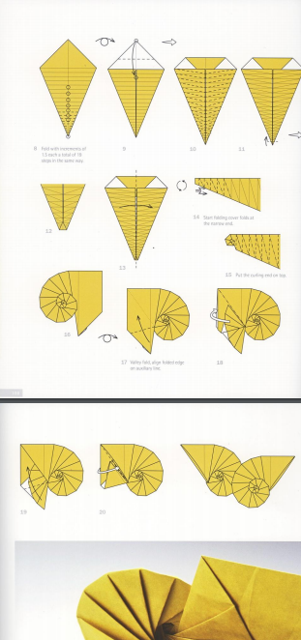
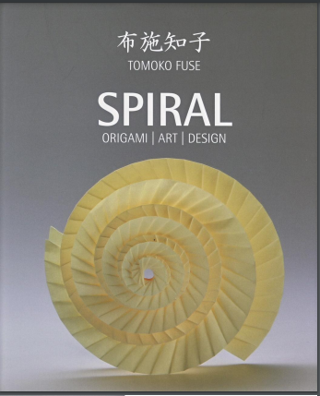
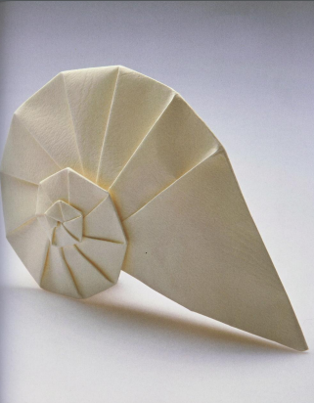
Origami
Tomoko Fuse’s Spirals: Navel Shell
Notes:
Tomoko Fuse is a super famous origami artist.
Take my word on that.
She does a lot of things with spirals,
has a whole book about them.
And another book about spirals and boxes
which is nifty
but not on topic.
Anyway, she had this
navel shell pattern
and many variations upon it.
***
Also, 300 pages later, I understand how to make that nautilus but
I no longer care about the sea creatures because, well, seashells.

Slide 10
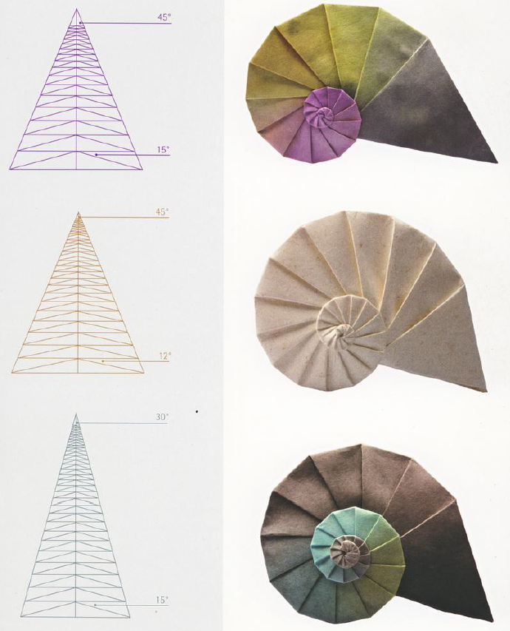
Triangles
Central and Spirality Angles
Notes:
I think this was the page that did me in.
Angles, triangle, modifying geometry to get
different physical structures.
A larger central angle (top of the triangle) leads to
a large body whorl and smaller protoconch.
A larger spirality angle (the smaller angle at the bottom) causes
the spiral to grow more quickly,
leading to a bigger
but blockier, less rounded form.
I didn’t choose angle names, they are from Fuse’s book.
But remember back to Raup and his
W which described how fast the shell grew?
And T which is related to how much of the old
whorl is covered by the new

Slide 11
Programming
https://github.com/eleciawhite/origami
Notes:
I wanted to reproduce the patterns from the Spiral book.
I’m accustomed to prescoring
which makes folding straight lines easier
and these needed to be precise
For prescoring I needed to make vector files.
I knew I’d use Python, numpy, and matplotlib
because I use that quite a lot for data wrangling for my gadgets
Still, how do you make a triangle with a bunch of
horizontal lines and some more triangles inside?

Slide 12
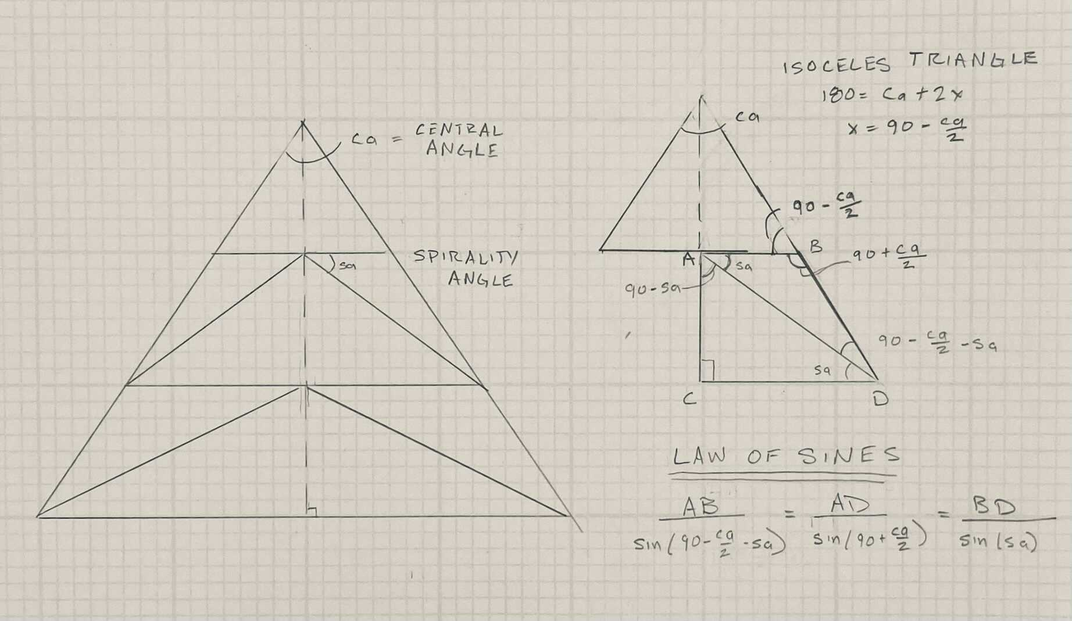
Develop the Navel Algorithm
Is this really an algorithm?
I’m just creating a triangle
Then adding a line with some other triangles
Then repeatedly adding another line until the end.
And finally containing it all in an outer triangle.
Notes:
I had two of three angles
which meant I could get all three.
I had to choose a length
and everything else fell out from the law of sines
once I remembered that was a thing
After I had one horizontal line with its two triangles,
I could go down to the next one and the next
and so on.
***
(I chose the initial horizontal length to be one.
Because, really, isn’t that secretly everyone’s favorite number?)

Slide 13
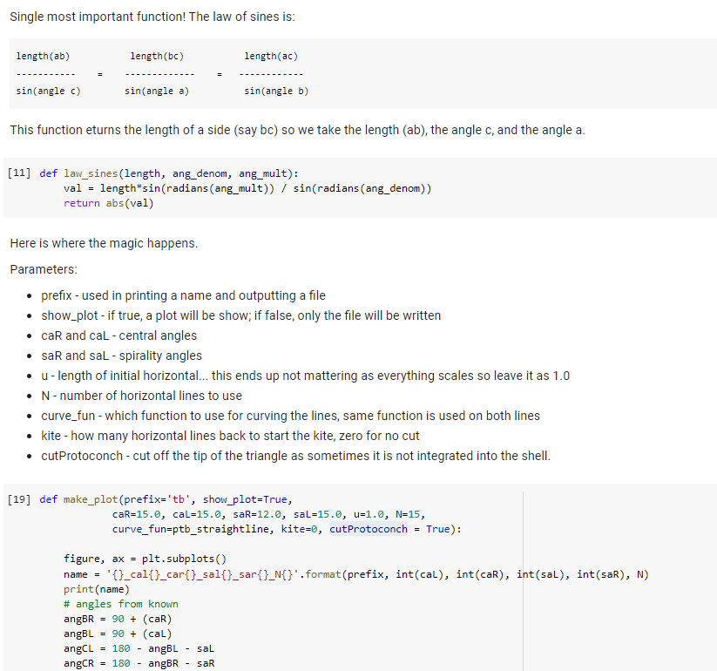
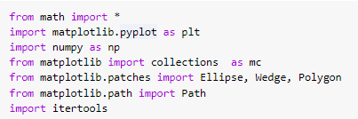
Python
https://github.com/eleciawhite/origami
There is also an online colab (like Jupyter) so you don’t need to install anything.
Notes:
I’m not going to go over the code with you.
But I will say that there is a colab
which is a way to intersperse code and text.
It is like Jupyter notebooks
but online so you don’t have to install anything.
Run it in your web browser.

Slide 14
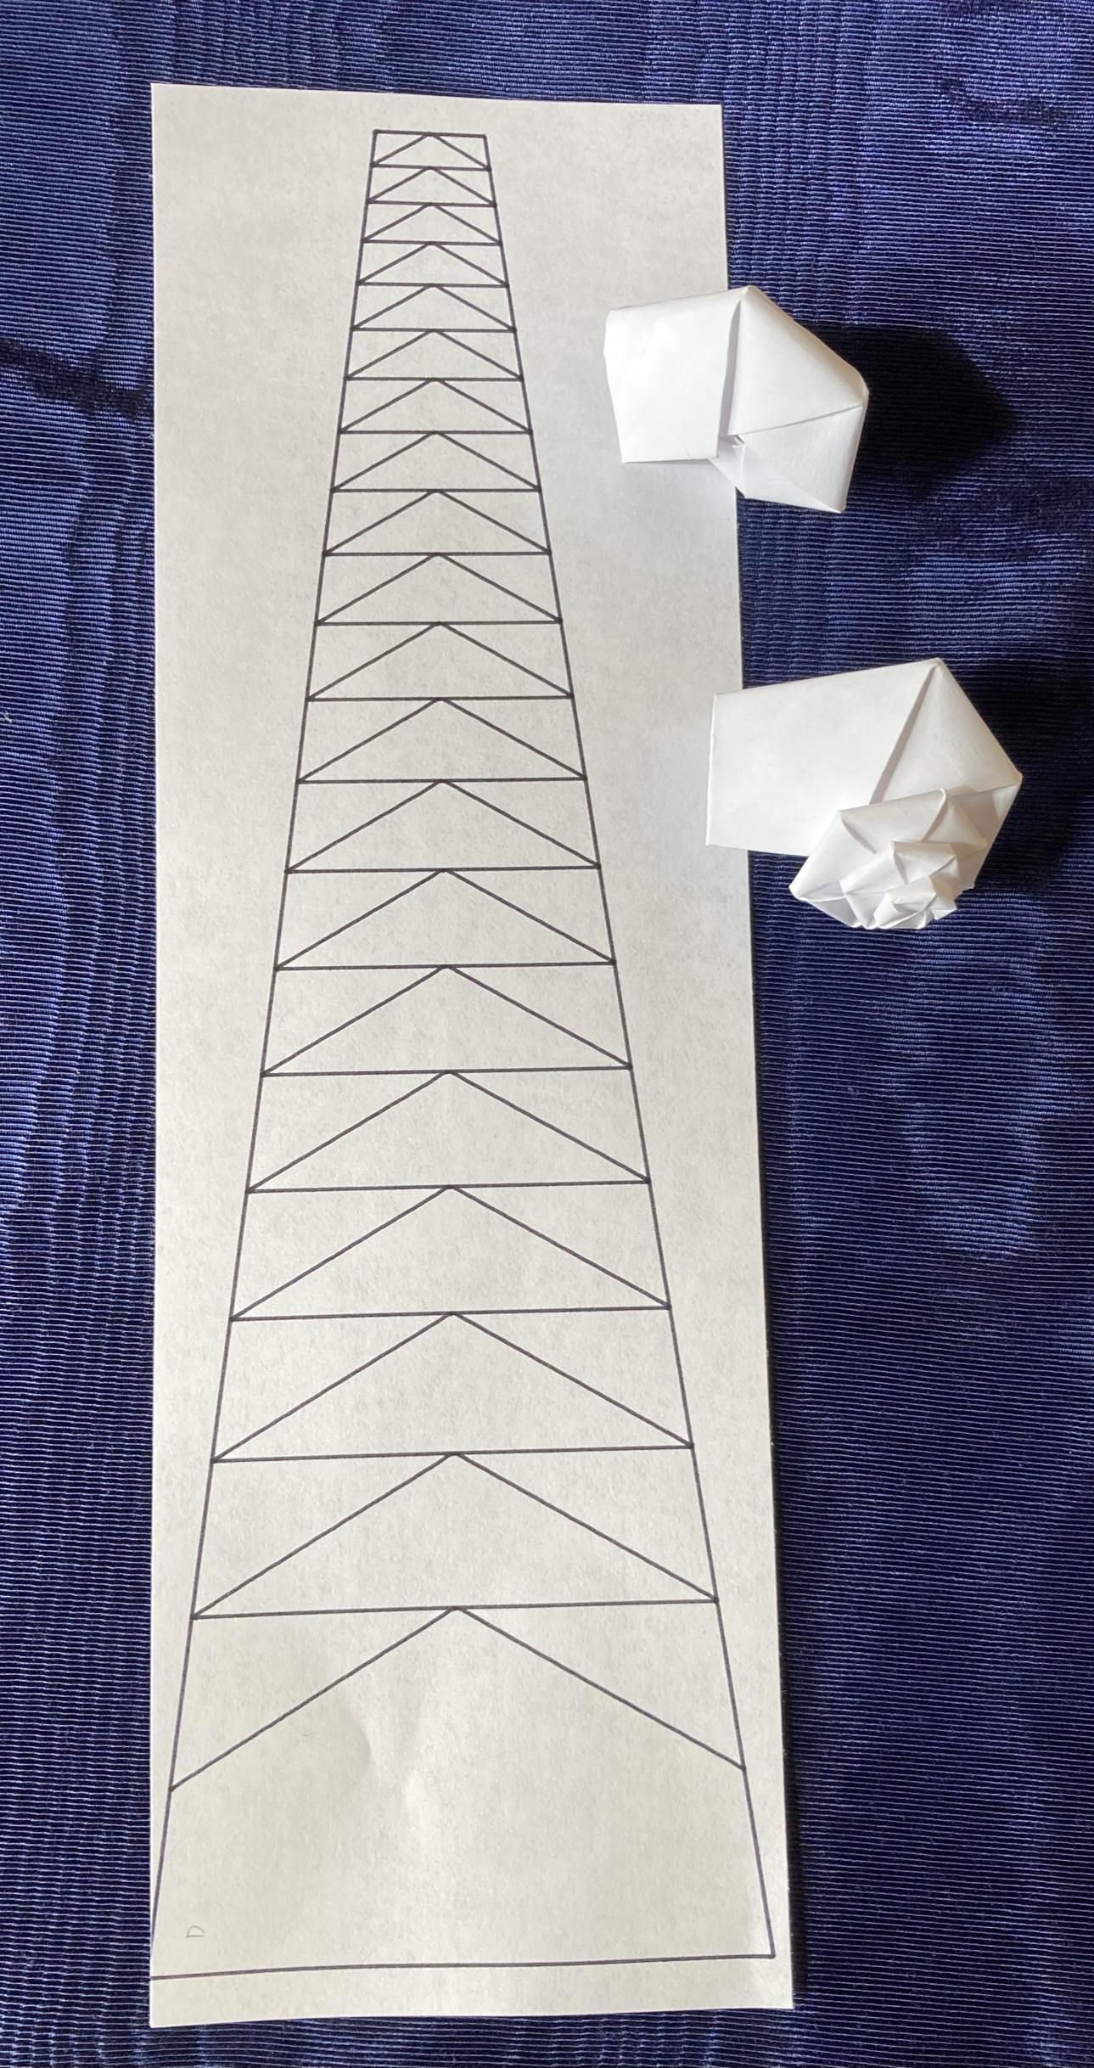
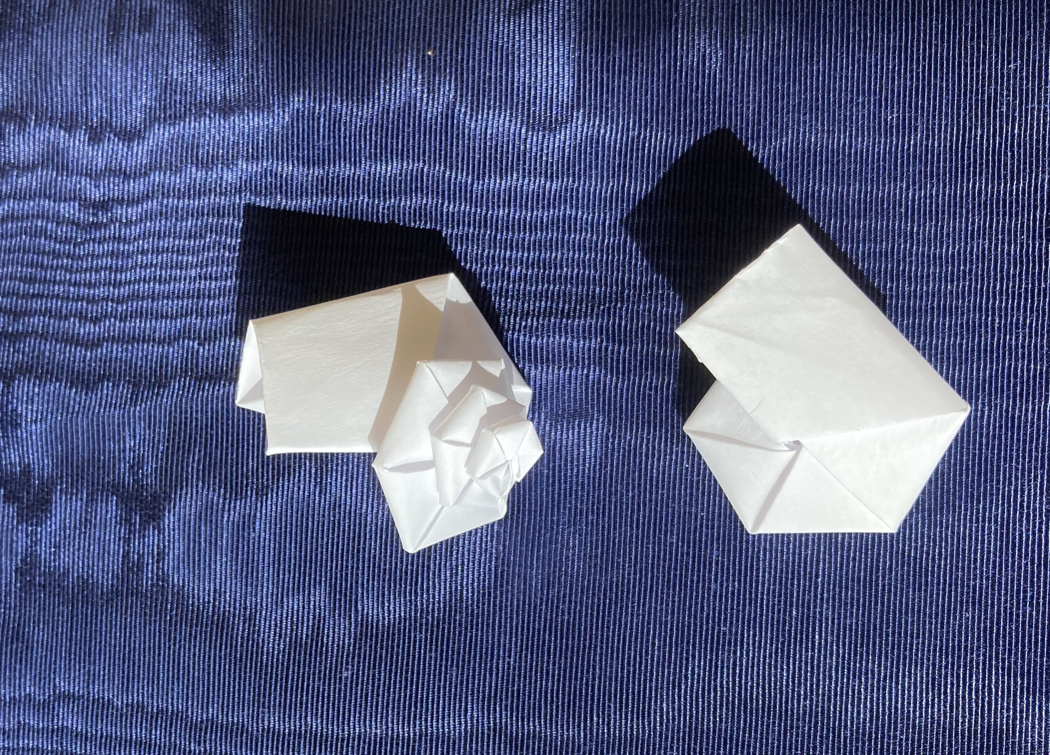
Fuse-Style Navel Shells
ca = 15
sa= 30
Notes:
(live show snails)
Mission accomplished: we have patterns that are easy to generate.
So here we have a pattern, a snail folded in on itself
and a snail that is pulled out like Fuse’s navel shells are.
There is a step in the folding where you pull out the protoconch
and then make every step after that a bit more difficult as you
work around paper that wants to fold in on itself.
However, It seems like the snails shouldn’t be flat,
they should be conical, turbinate.
Flat snails is … a sad blues song.

Slide 15
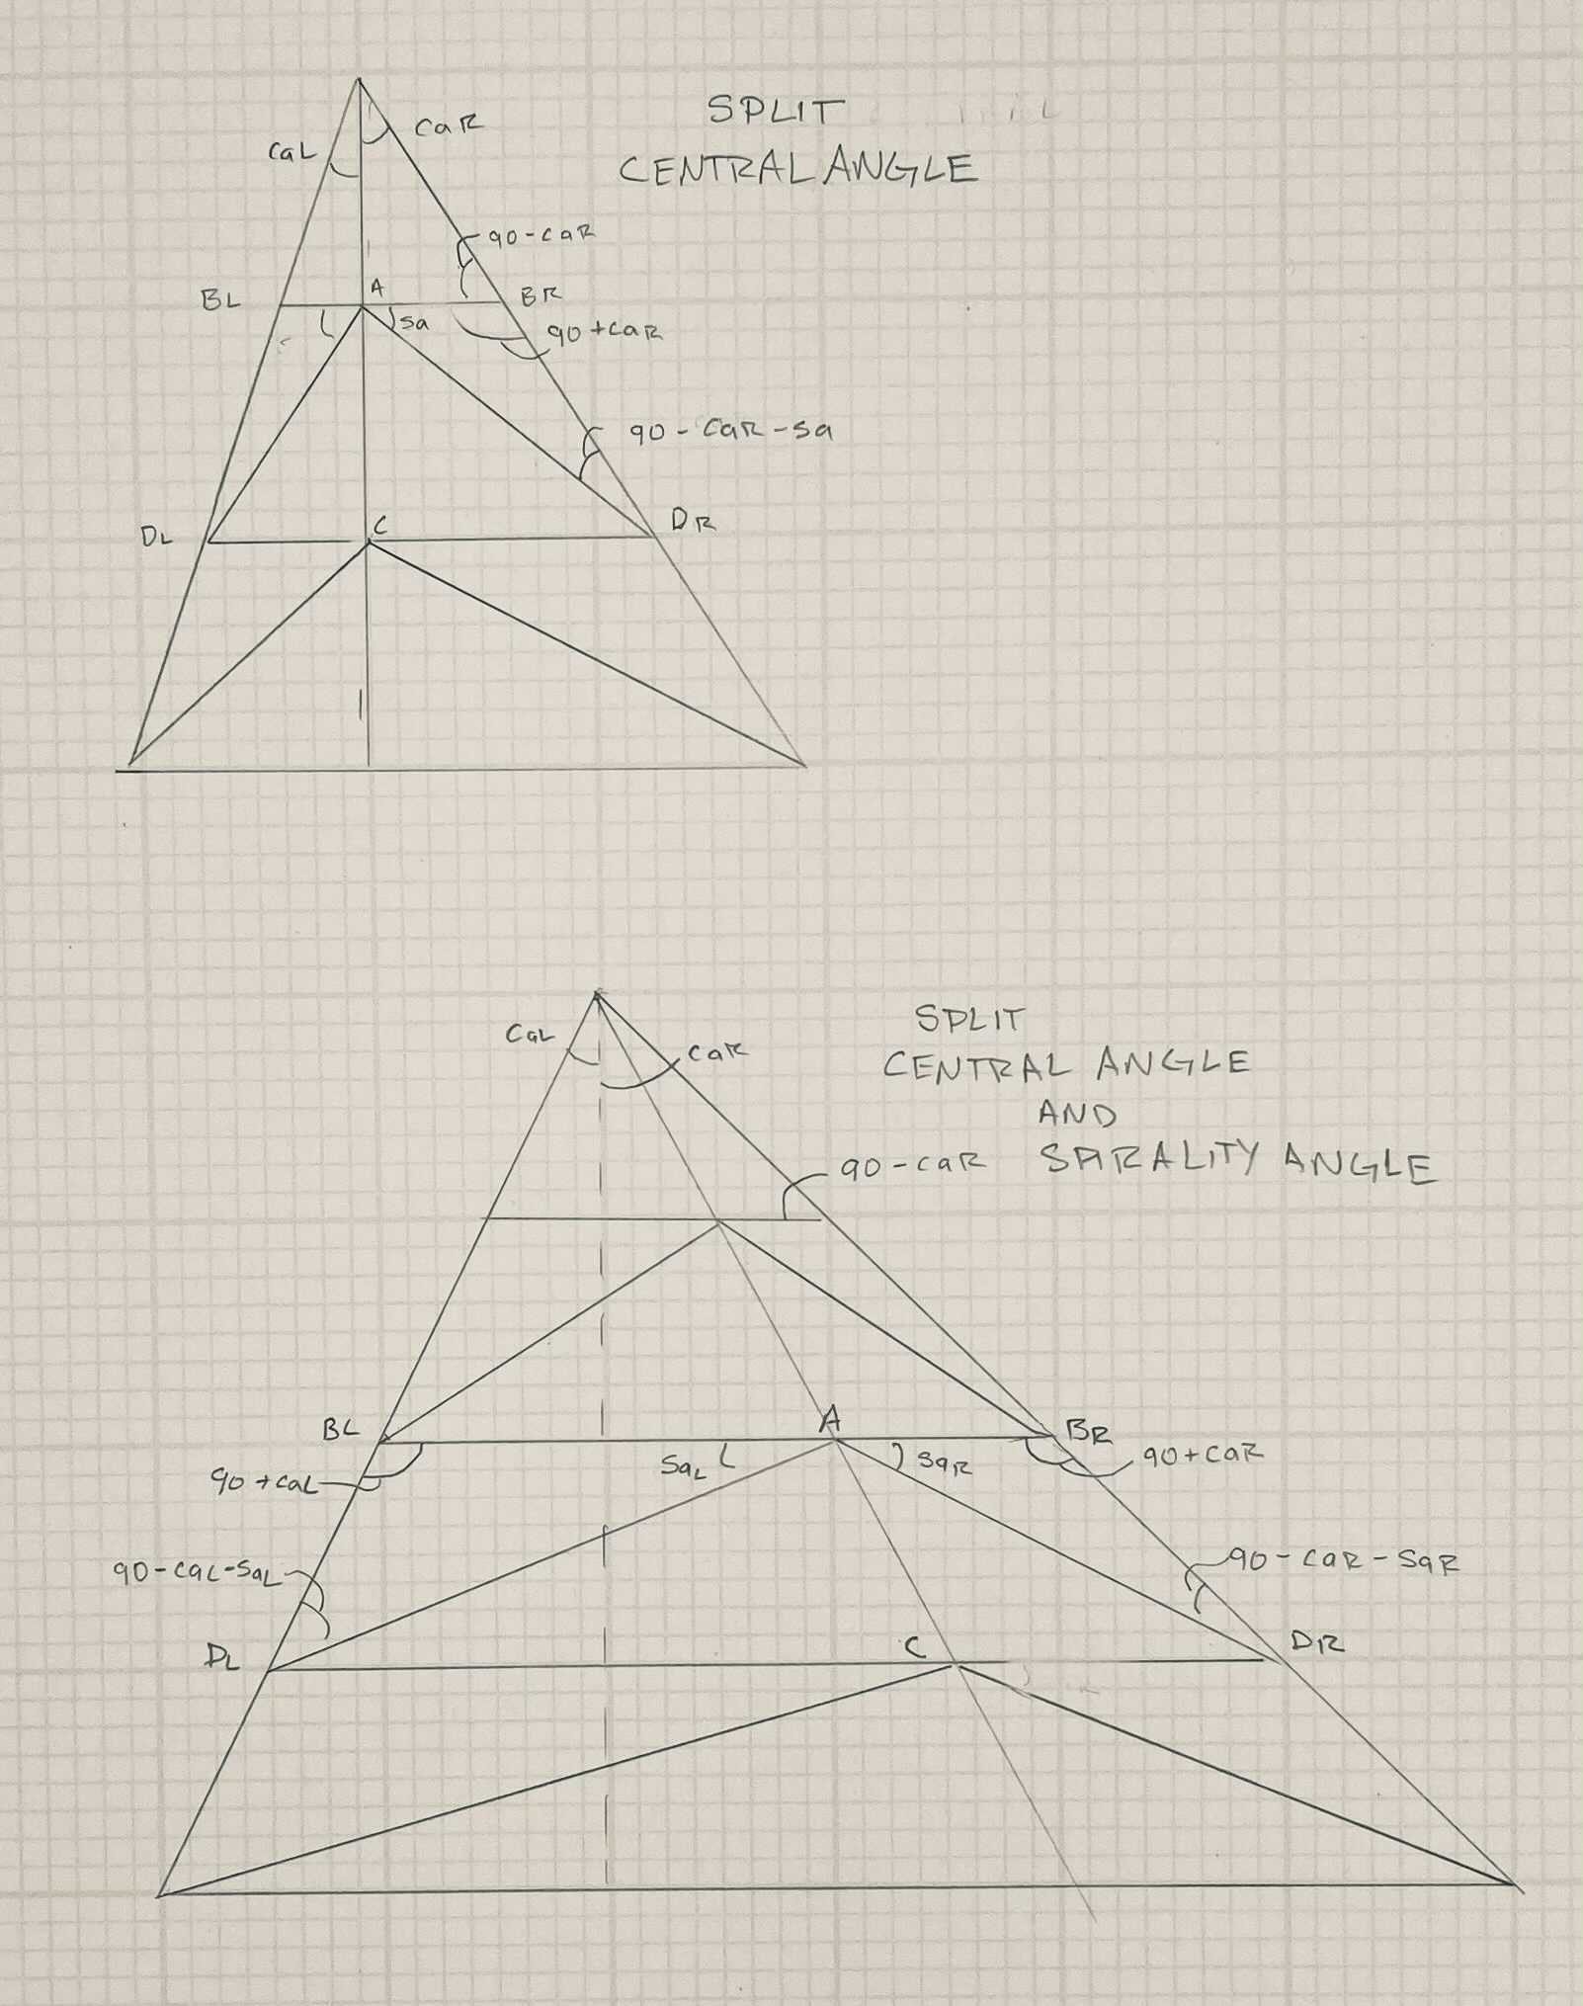
More Geometry
This is no way to lead your life.
Though maybe it is.
I mean, I feel pretty good about myself after doing math. Like I’m smart and know stuff.
Ada Lovelace used to do calculus problems for fun. When I first read that, I thought it sounded interesting. I wished I could do it.
Then I realized… no one is stopping me. Except me.
Notes:
It seemed like there might be a better way.
What if the central angle wasn’t balanced?
What if the spirality angles weren’t balanced?
Why do I spend so much of my free time doing geometry?

Slide 16
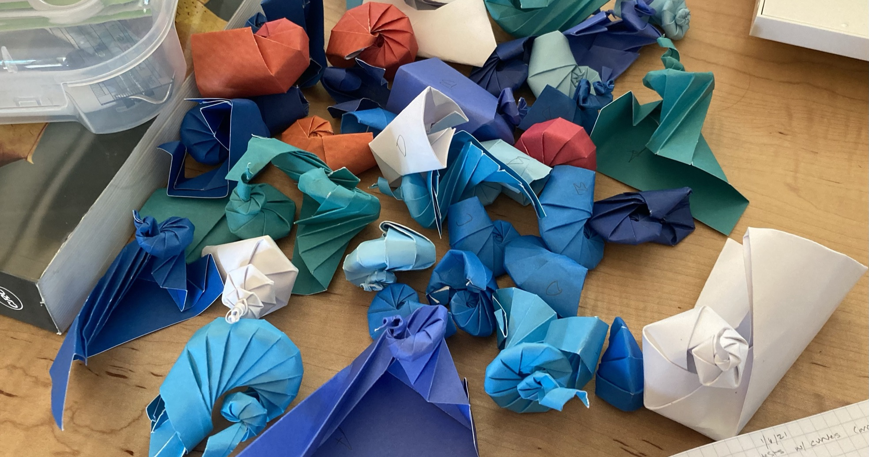
Notes:
It turns out
Evolution is cruel
and there are many parameters
that do not work.
This, by the way
is why I needed to learn
about Raup’s shell description method.

Slide 17
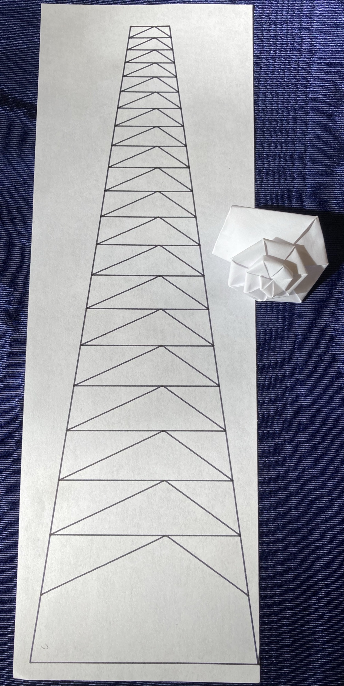
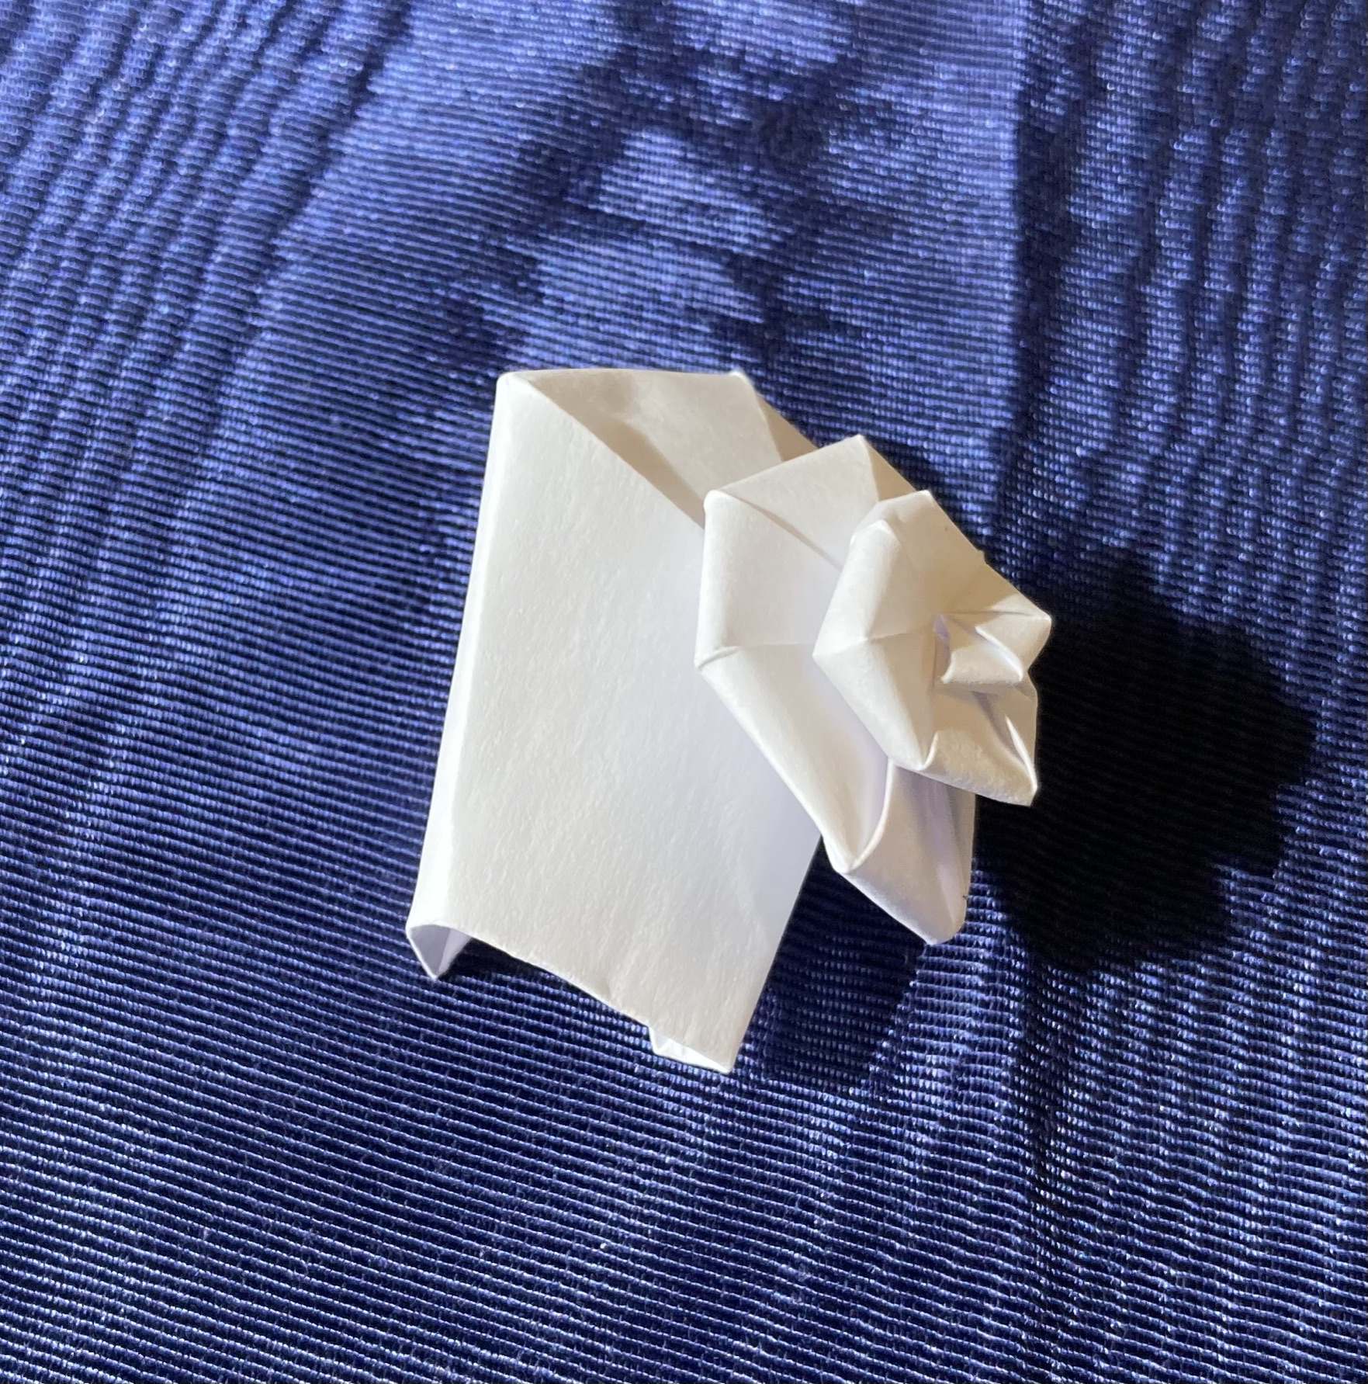
Unbalanced Spirality Angle
caL = caR = 7.5
(ca = caL + caR = 15) saL= 35, saR = 25
Chirality
Notes:
(Live show snails)
But some parameters do work.
Here the spirality angle is unbalanced,
it doesn’t look a lot different from the unmodified one
but it is easier to fold.
One neat thing here,
where the parameters aren’t balanced
we get the idea of chirality,
are they curling left or right?
Snails are hermaphrodites,
their bits have to line up.
Their shells have to have
the same chirality
in order to make baby snails.

Slide 18
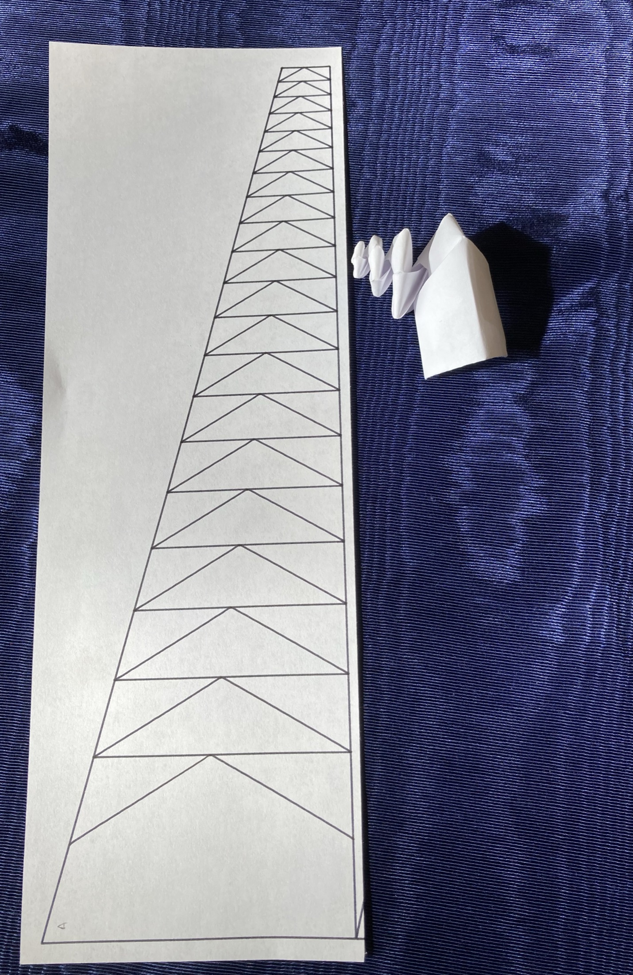
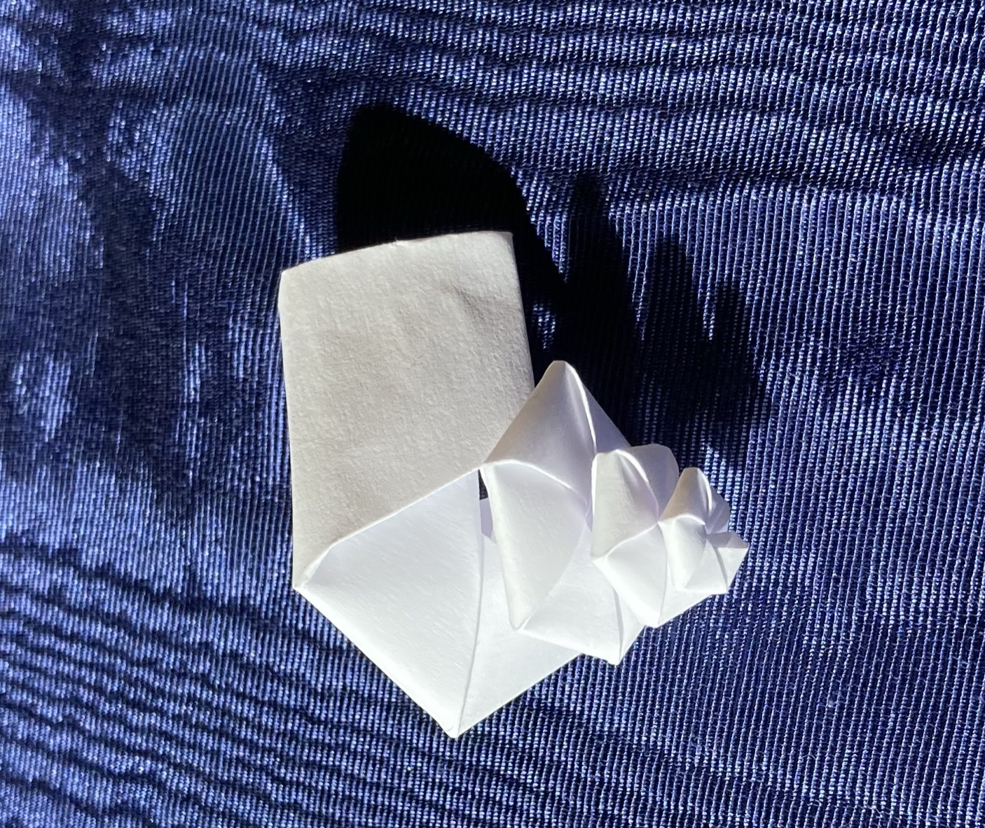
Unbalanced Central Angle
caL = 0, caR = 15
saL= saR = 30
Notes:
(Live show snails)
On to an unbalanced central angle
Very nice height, whorls don’t touch much which
happens for some marine snails but…

Slide 19
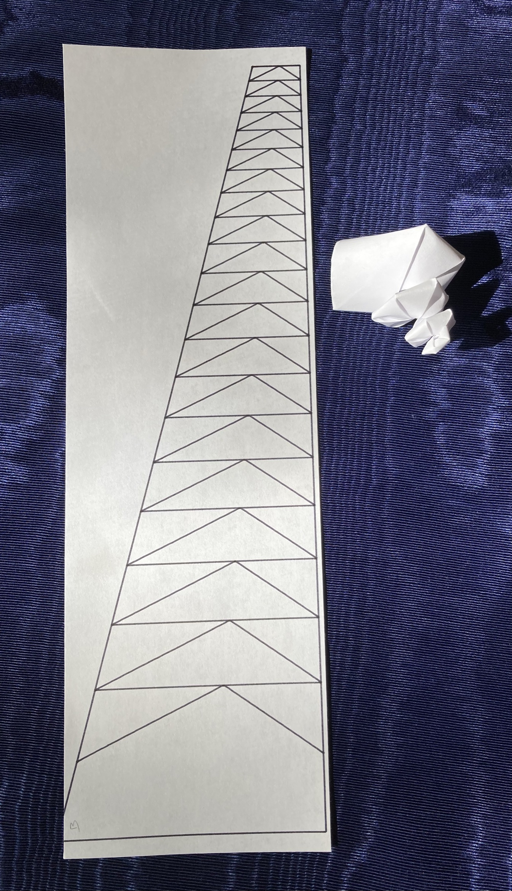
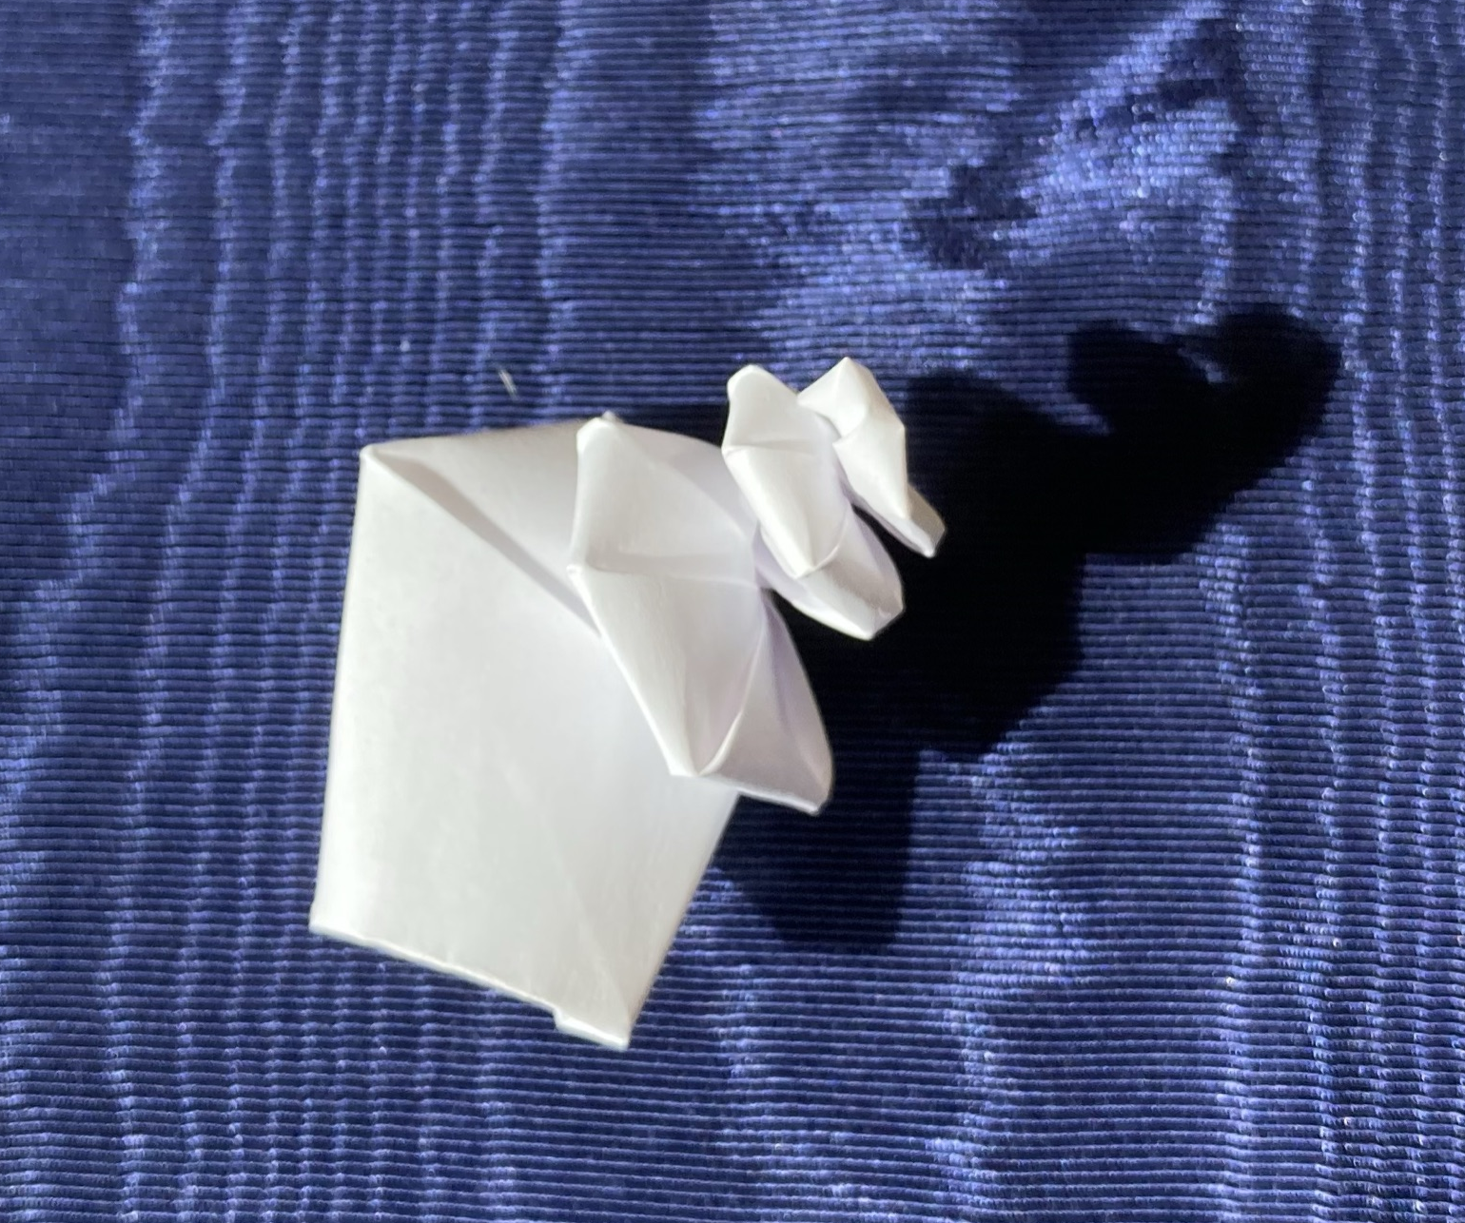
Unbalanced CA and SA
caL = 0, caR = 15
saL= 35, saR = 25
Notes:
(Live show snails)
Putting it all together we get a pretty good turbinate snail.
Nice height and the whorls touch
Chunky but we know if we decrease spirality,
the snail will grow more slowly and be smoother.
But wait… what if we add in curves?
What if we replace the straight lines with Bezier curves?

Slide 20
Curved Copy Paper Snail
caL = 0, caR = 15
saL= 35, saR = 25
Bez =0.95
Notes:
(live show snails)
Earlier I mention curved crease and cardstock
so you can be suitably impressed
that all the white snails I’m showing
are made of copy paper.
Ehn, I know you aren’t suitably impressed
but let me tell you,
origami people would be wow’ing right now.
Though they are such snobs about paper,
maybe they’d be closing their Zoom windows instead…
Anyway, I used copy paper instead of something fancier
so you know you can make these,
either make your own by running the script
or get a working SVG from me.
***
I had kind of hoped to fold one together as we talked but…
but ten minutes.
Also, I realized I’d be the one talking,
I usually only fold in meetings
when other people are talking.
And my camera is off.

Slide 21
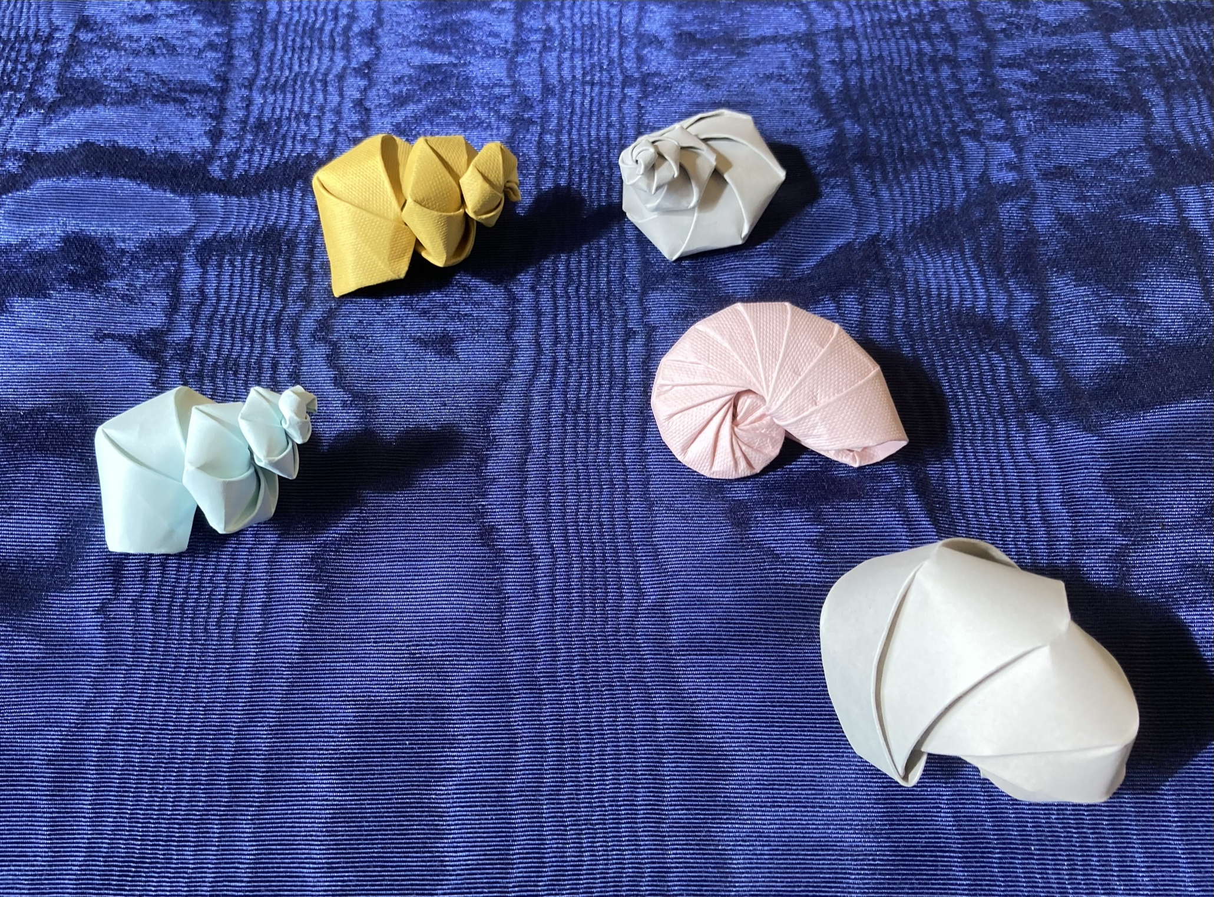
More Paper Snails
Turbinate
caL = 0, caR = 15 saL= 35, saR = 25
Planispiral
caL = caR = 25 saL= saR = 17
Notes:
(Live show snails)
Anyway, copy paper is hard, cardstock is easier
I can do planispiral as well, nice nautilus that curls in on itself.

Slide 22
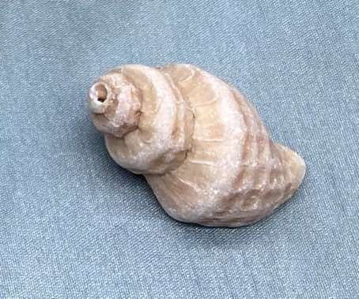
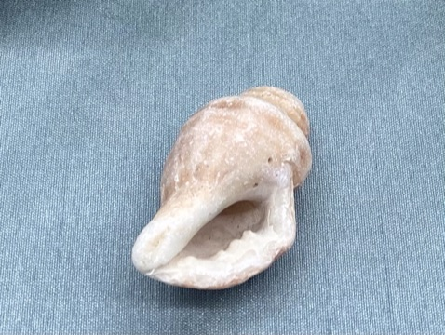
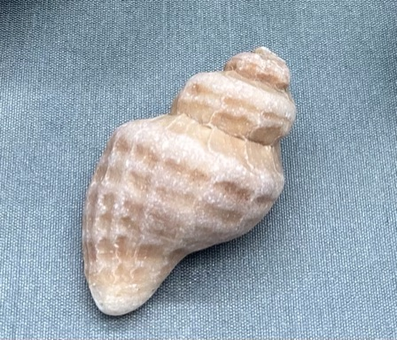
Next: Conches
Notes:
(live show conch?)
I have plans for continuing, I’m hoping to make conches.
It has proven to be much harder…
The aperture… err…
generating function is no longer circular…

Slide 23
About Me: Elecia (Engelman) White ‘96
I’m an embedded software engineer; I write software for things that aren’t computers. The applications are endless.
I’m a consultant and my company is Logical Elegance, Inc.
I wrote O’Reilly’s Making Embedded Systems, a great-eared nightjar.
CW ’96 and I host the Embedded podcast where we talk about engineering, science art, teaching, and sometimes embedded systems.
Mudd Individual Program of Study: applied CS and theoretical engineering (programming and Fourier). Two concentrations: art and theories of learning.
I really like snails. And origami. And robots.
Notes:
A quick slide about me
I think the important bit here is that
Chris White and I host a podcast
called Embedded
where we talk about STEM/STEAM topics
It is in all the usual podcast apps.
And we really like Mudders as guests.
Our previous speaker,
Dan Shapiro was on our show years ago,
when Glowforge was getting off the ground.
I’m easy to find online if you want to chat about being on the show. Or snails. Or robots. Or the half dozen slides I had to cut out to get near 10 minutes.

Slide 24
Thank you!
Insert snail joke here.

Slide 25
Sources
Mollusk Morphology
Computer as Aid in Describing Form in Gastropod Shells. Raup, David M, 1962.
Geometric Analysis of Shell Coiling. Raup, David M, 1966.
A Natural History of Shells. Vermeij, Geerat J, 1993.
Snail Facts
Spirals in Time: The Secret Life and Curious Afterlife of Seashells. Scales, Helen, 2015.
Origami Books:
Tomoko Fuse: Spirals
Jun Mitani: Curved Folding Origami Design
https://github.com/eleciawhite/origami (colab)
Notes:
https://en.wikipedia.org/wiki/Gastropod_shell
https://en.wikipedia.org/wiki/Whorl_(mollusc)
https://en.wikipedia.org/wiki/David_M._Raup

Slide 26
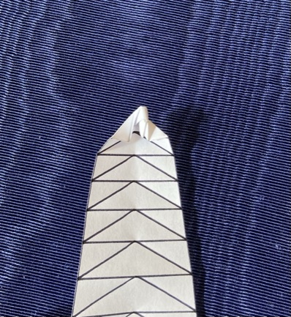
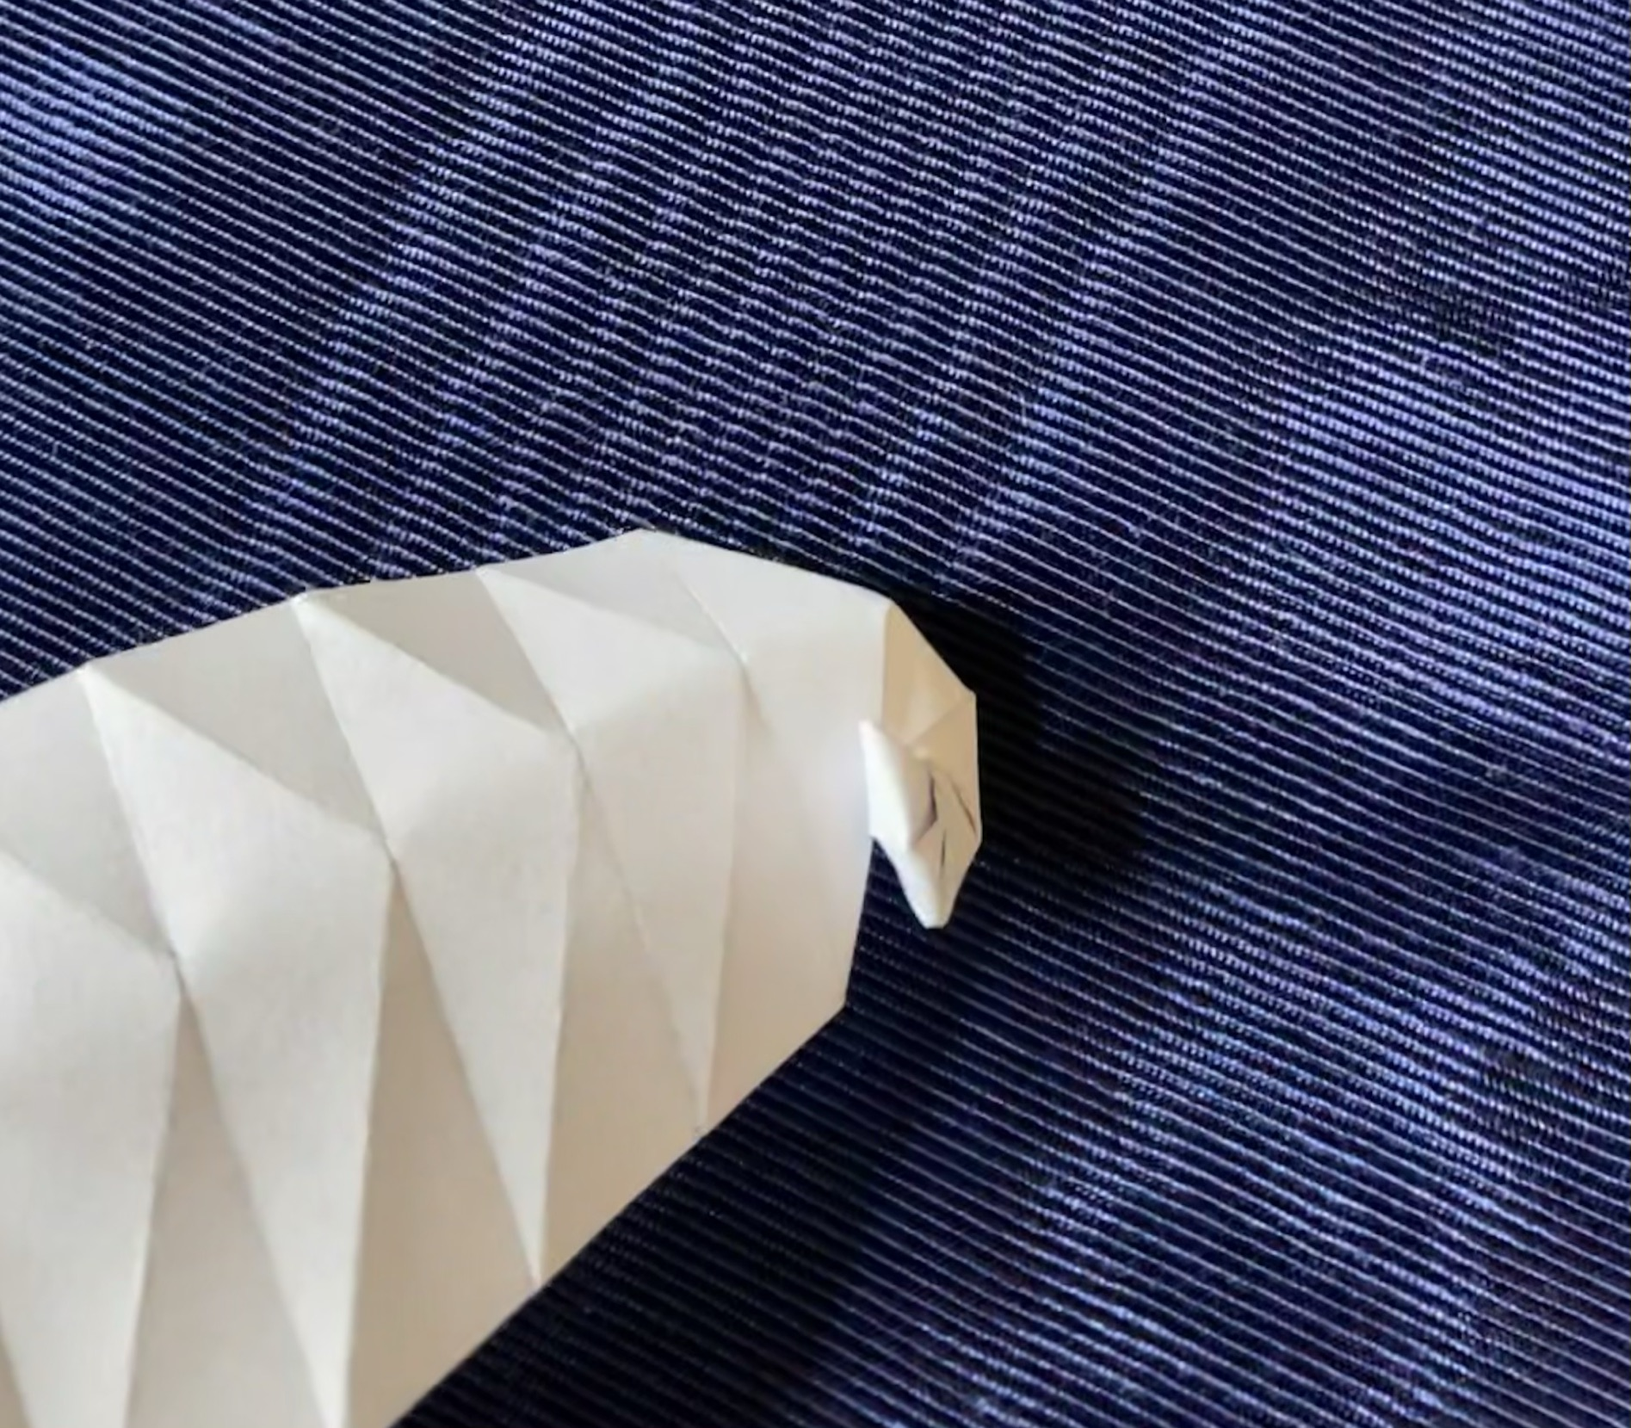
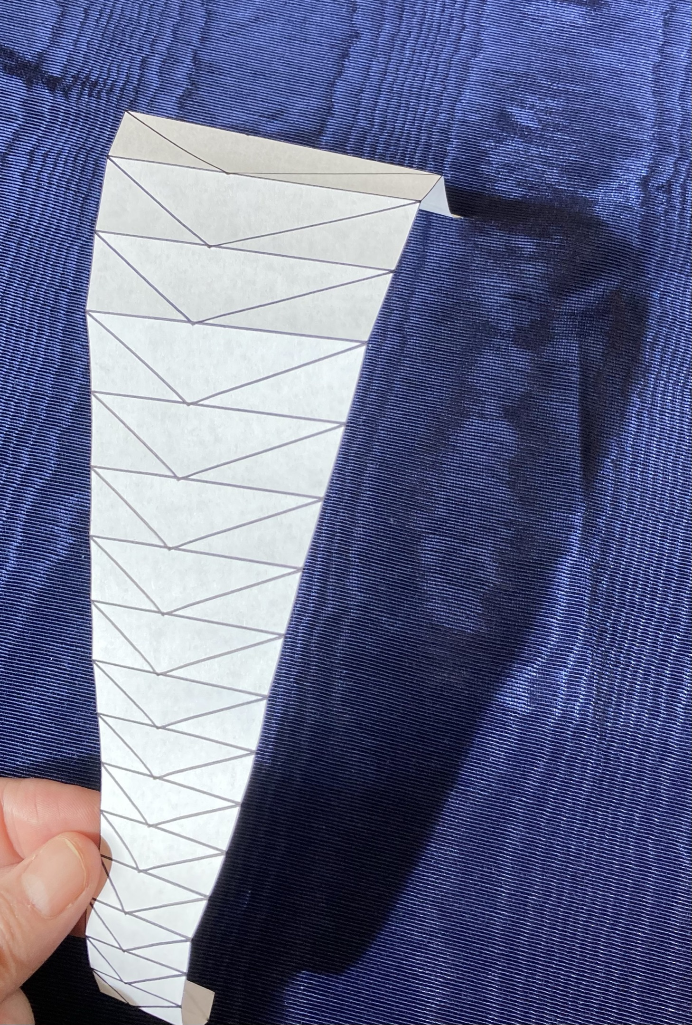
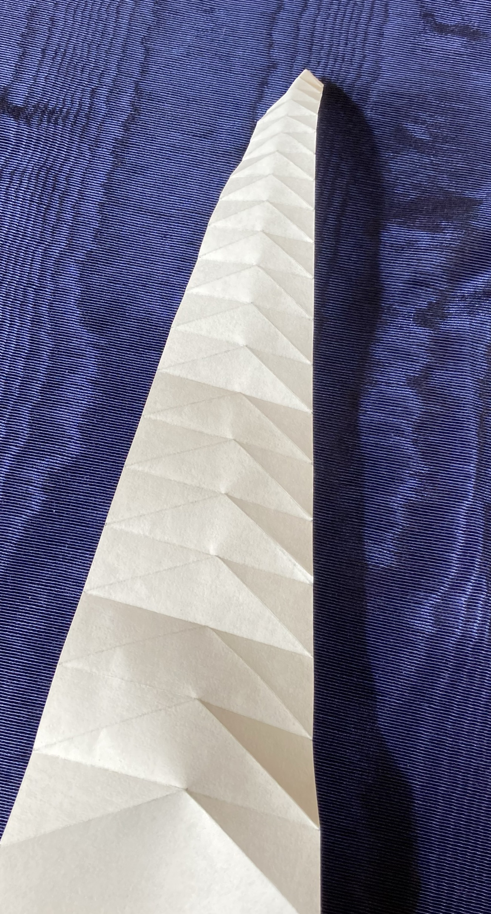
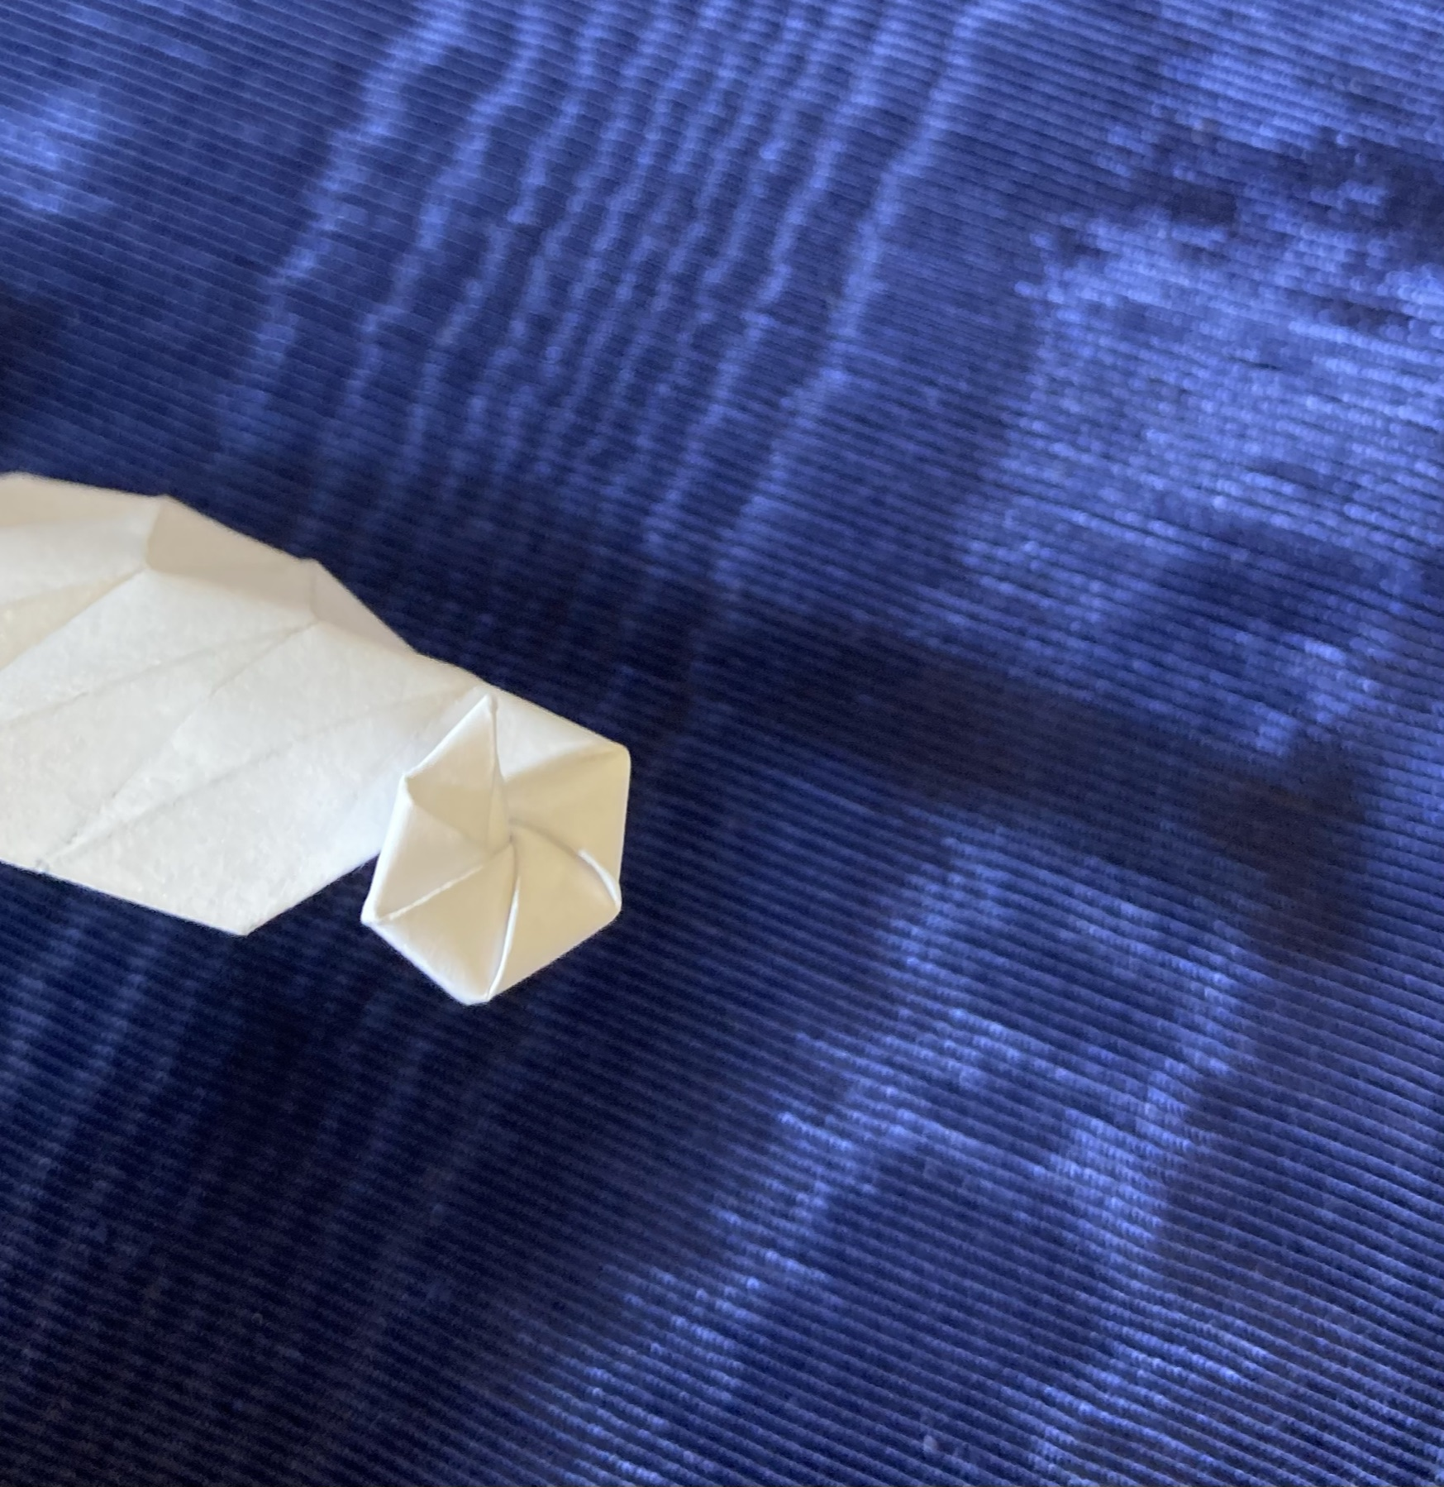
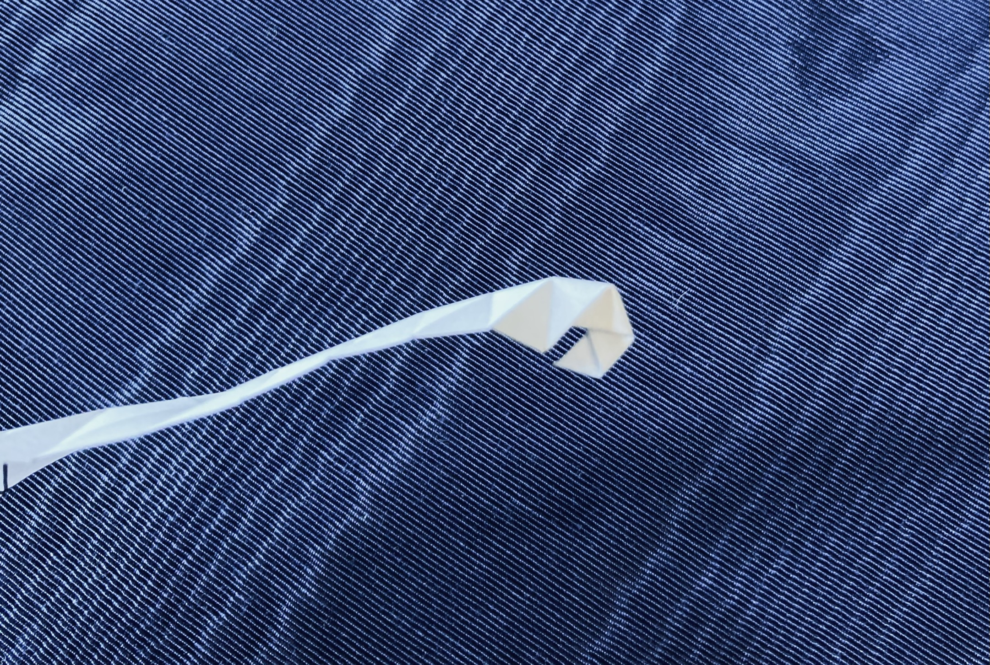
Folding Triangles: 4 steps
Notes:
To fold these, you
Print out the pattern, cut the shape.
Fold all the horizontals one way, we’ll call this mountain
Fold all the diagonals the other way, we’ll call this valley
Then do an inside reverse fold at the tip.
No, seriously, you just follow the creases and make a little tip
Then you keep folding back and forth
And then you get to the point where the tip is going to get hidden, you push it out
Which makes folding things on that side a bit tricker as you have to tuck things into the body whorl
And then, viola, you have a snail.

Slide 27
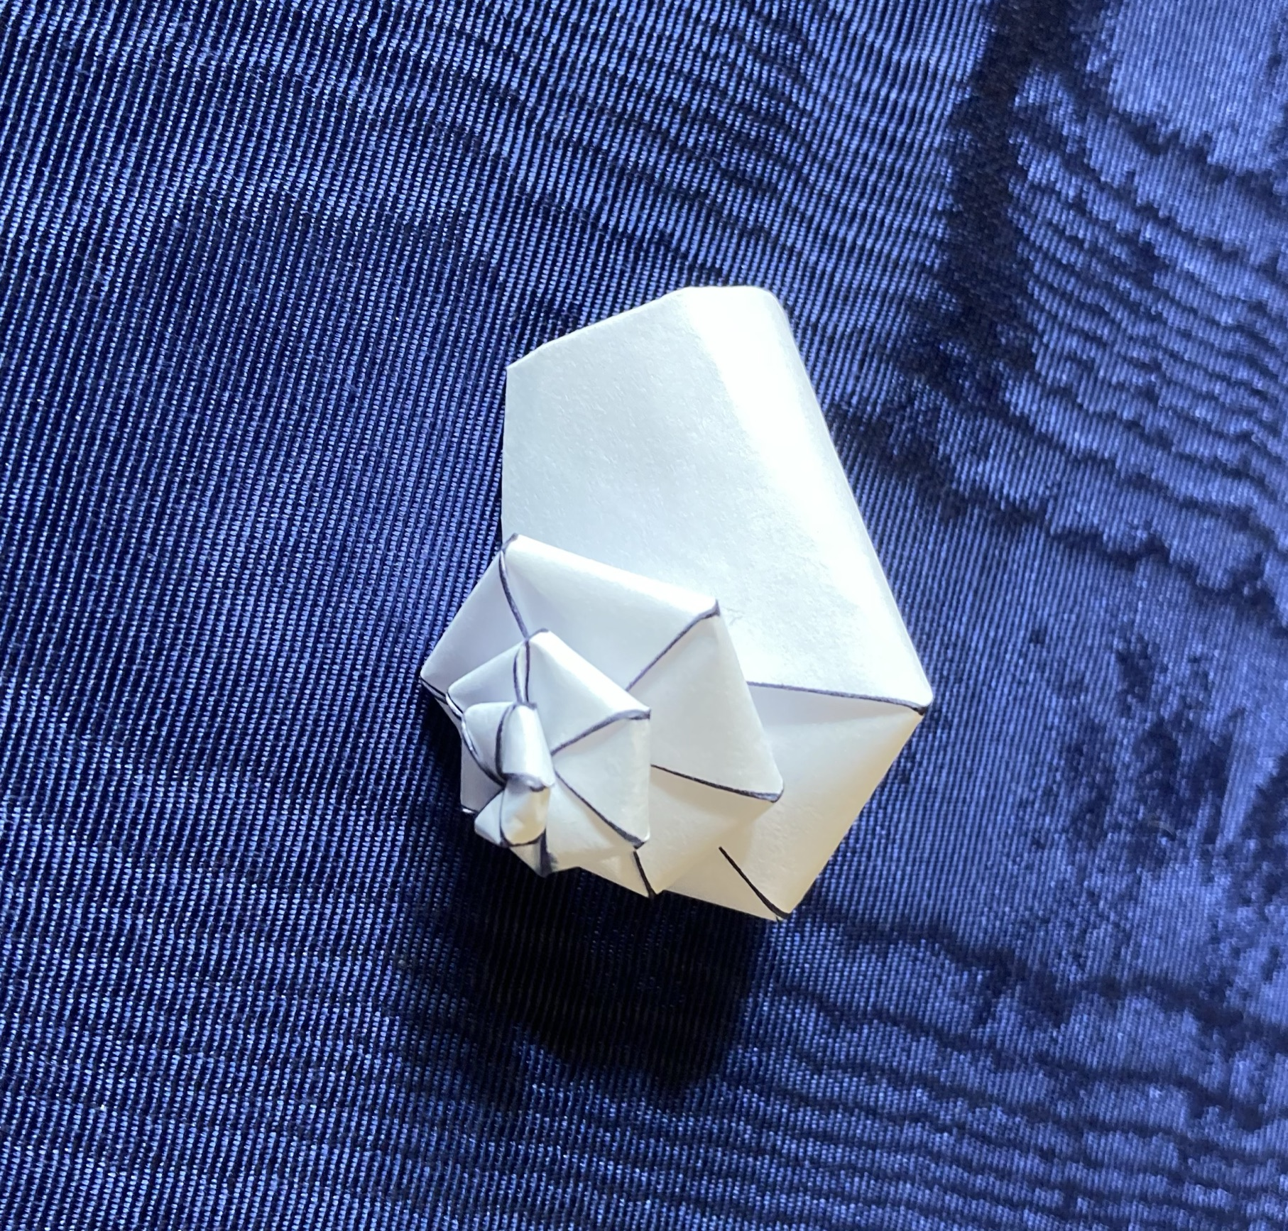
Notes:
Voila

Slide 28
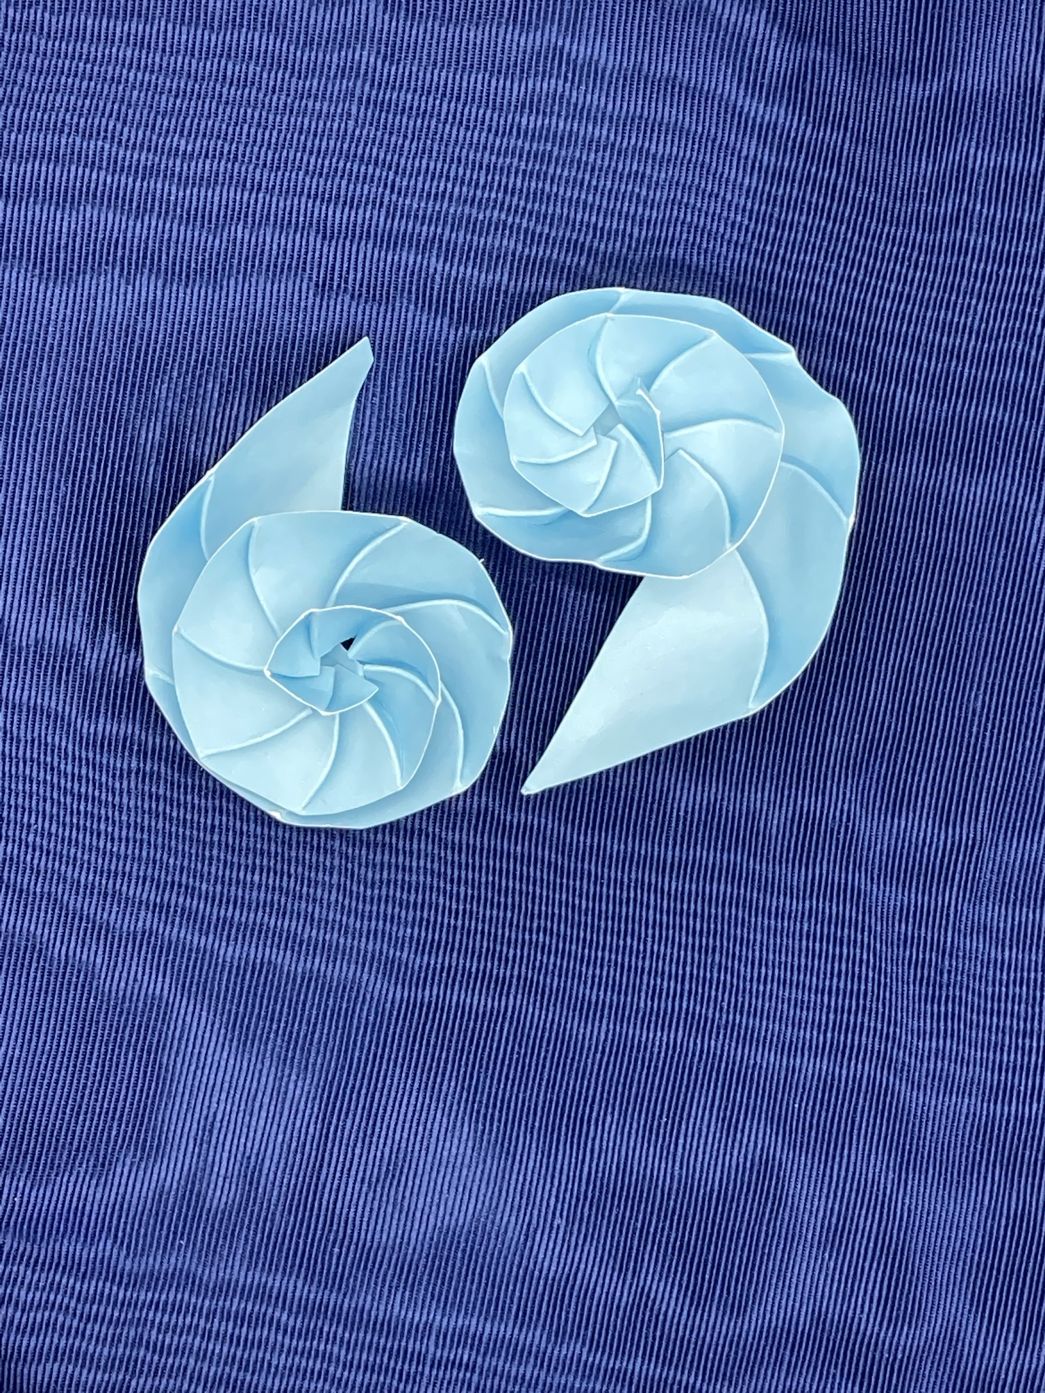
Nautilus Half-shell
Notes:
Easy to fold, cut a planispiral pattern in half.
Easier to do that than to cut an actual snail in half.
Shows septa (interior lines between whorls)…
these are wholly internal to snails
though they can appear in the origami

Slide 29
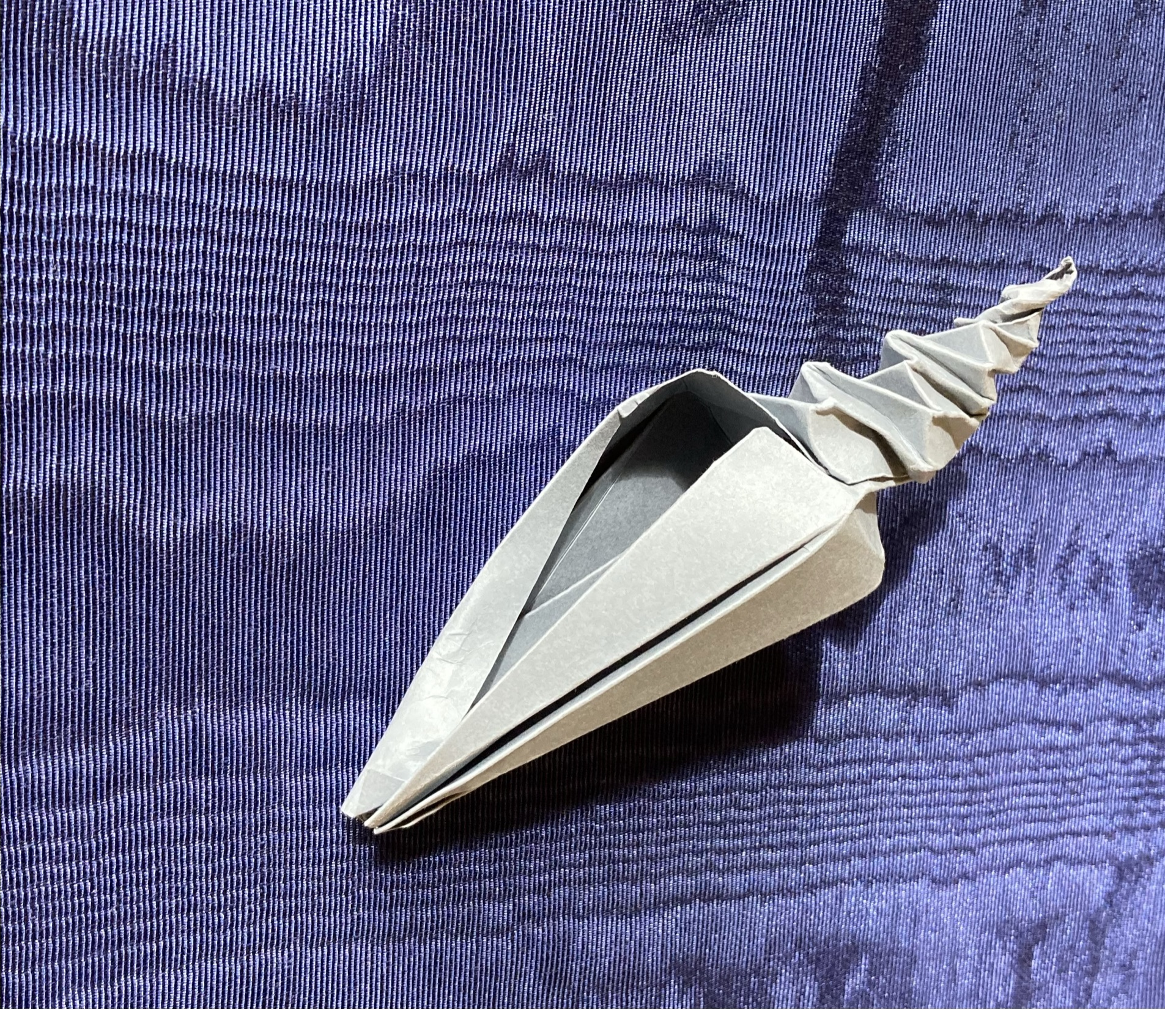
Conch? Needs work.
Notes:
Not quite there yet but I’m not out of ideas either
This is in curlpool.py in the git repo.
It uses a different method to generate patterns,
based on Fuse’s whirlpool patterns and screw shell pattern.
It also uses matpolotlib’s paths and patches to much greater effect which speeds prescoring as well as actually using existing tools instead of inventing new ones.

Slide 30
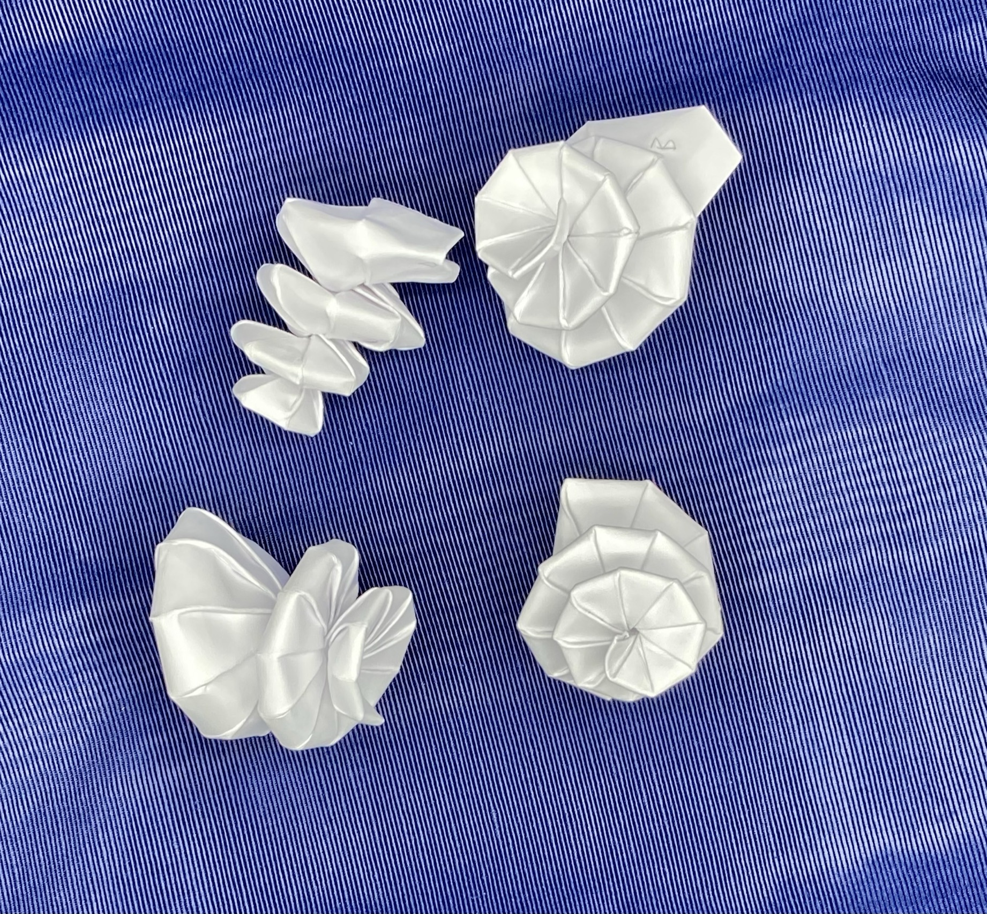
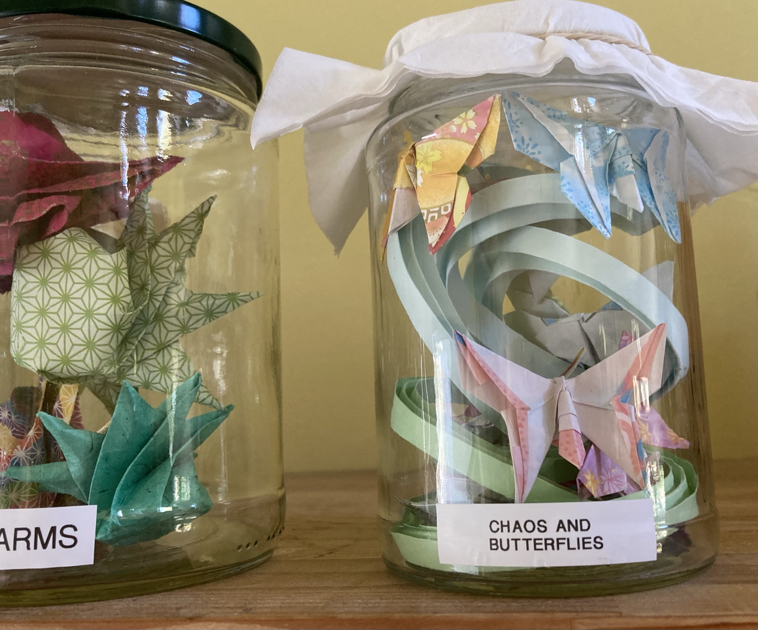
?
Notes:
Really neat failures. Pushing the Bezier curves as far as the paper will let them go

Slide 31
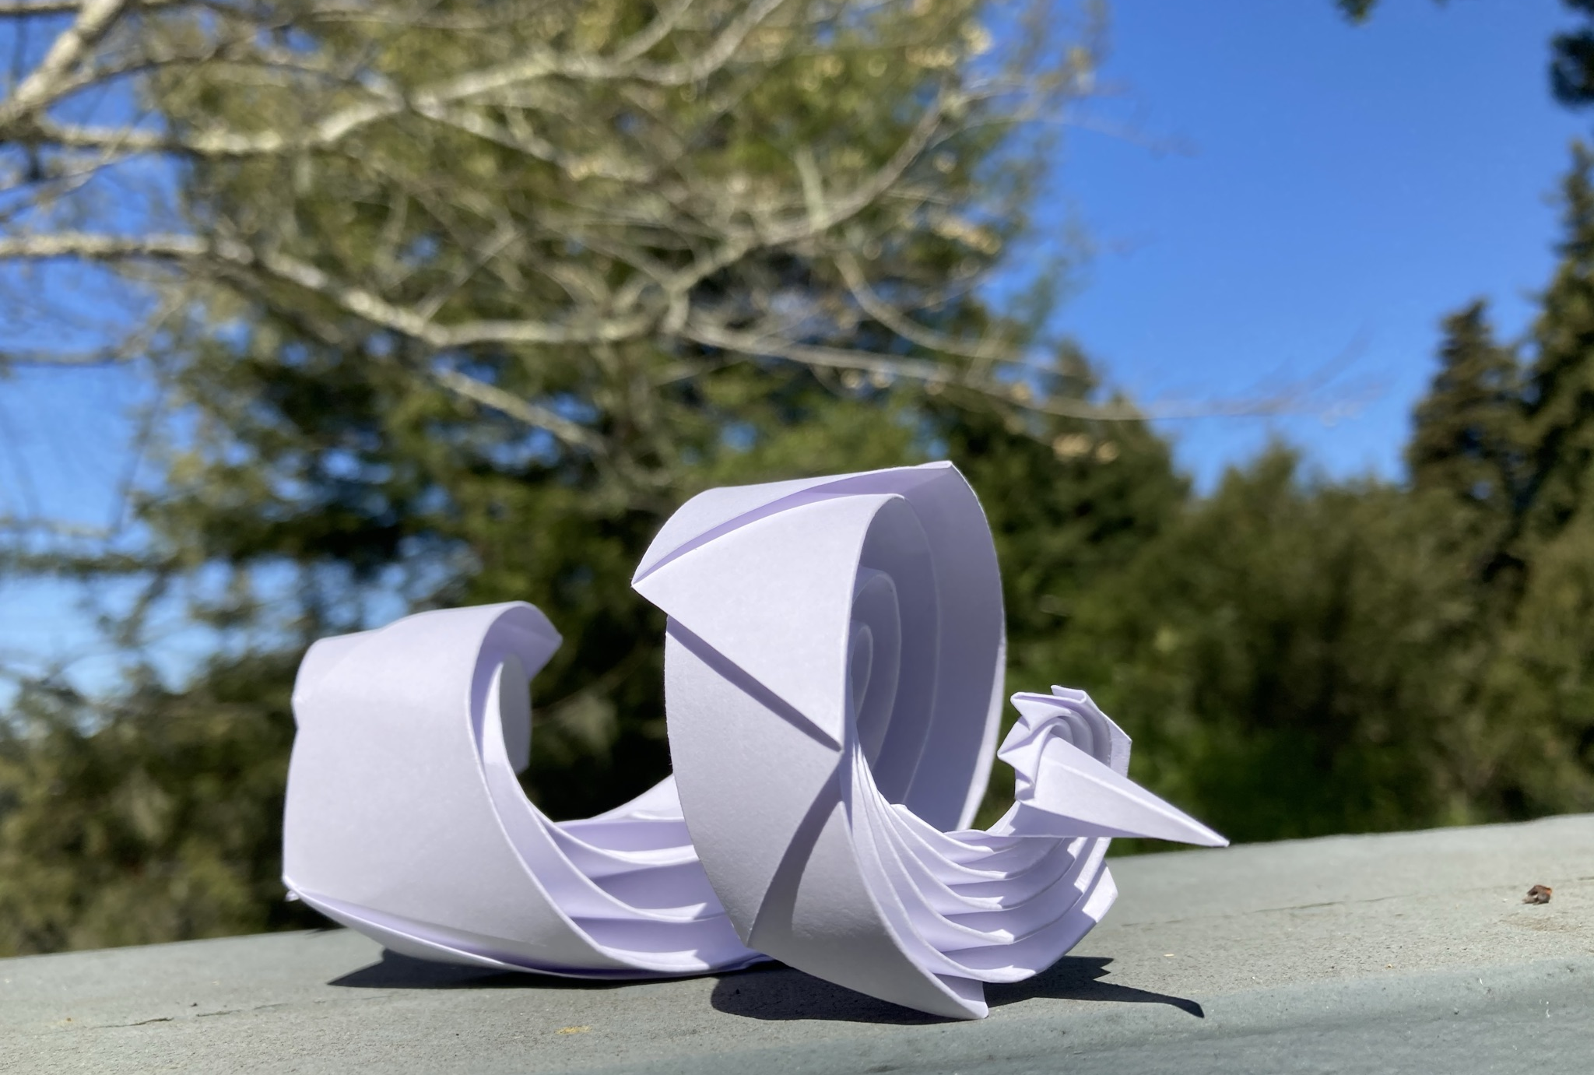
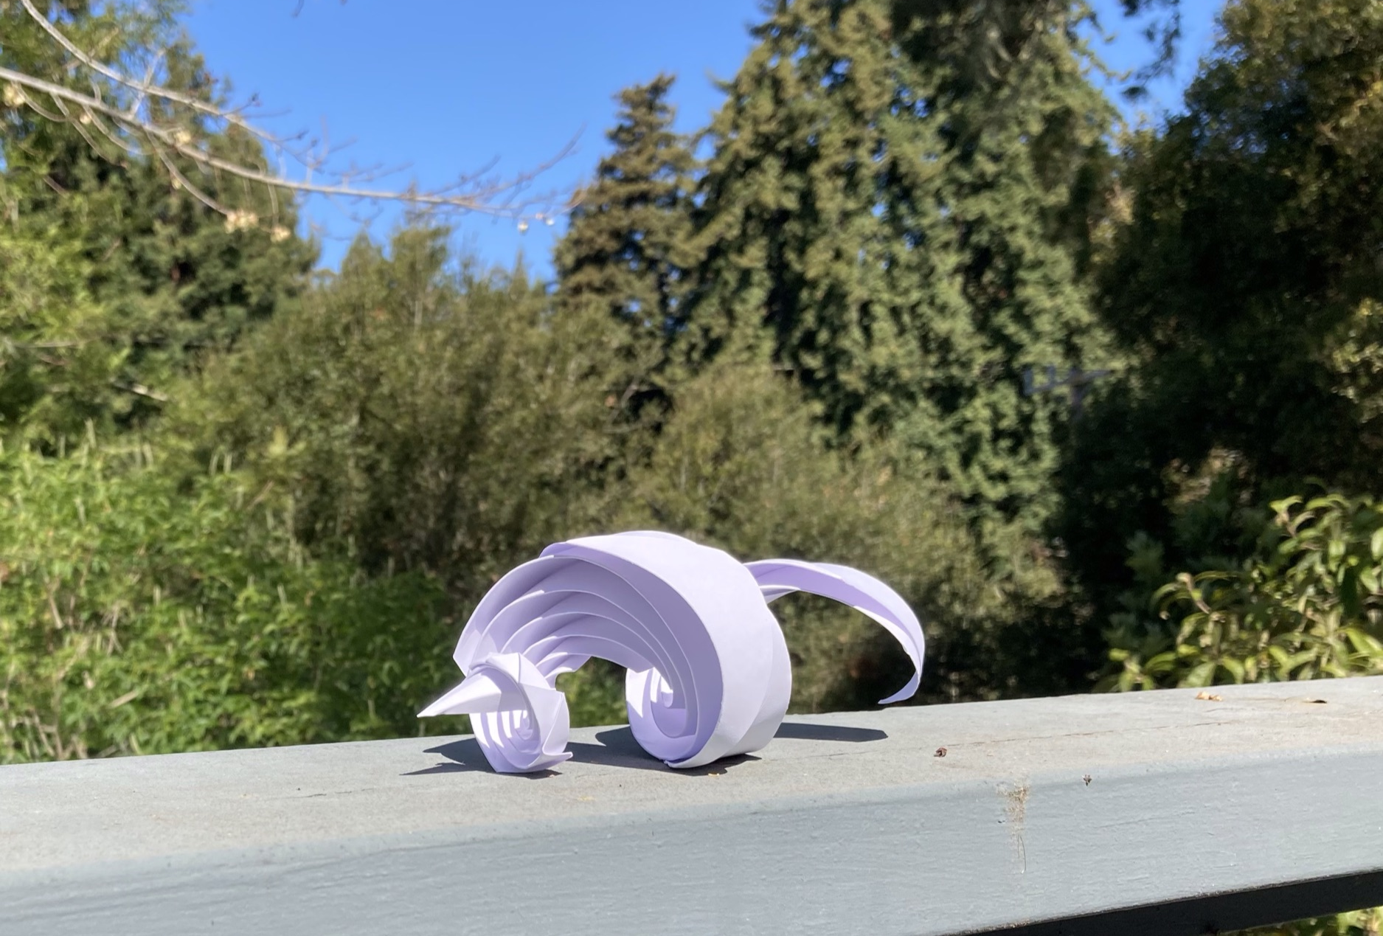
Luck Dragon
Curved crease and pleated
Notes:
Totally an accident

Slide 32
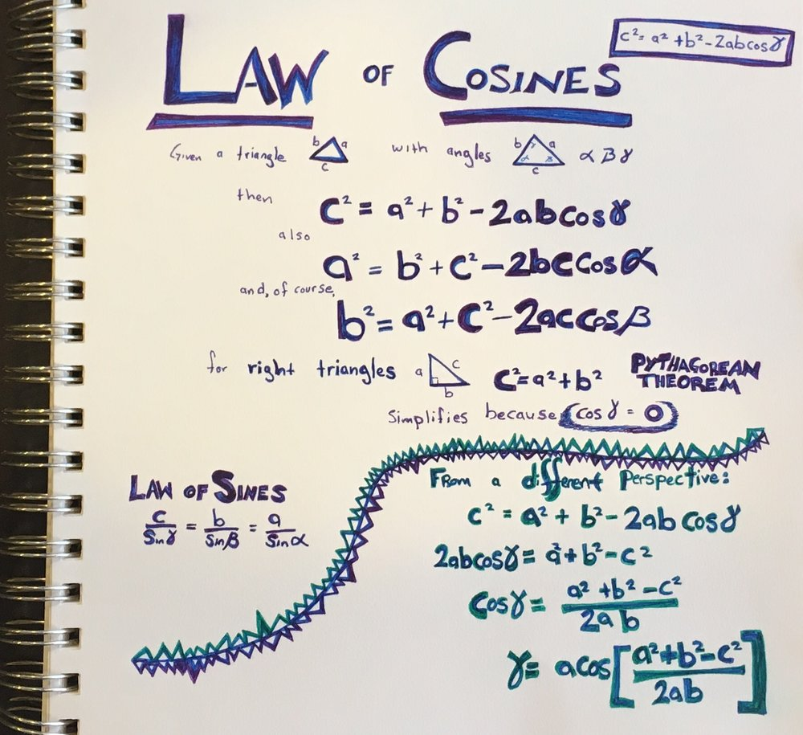
Programming Triangles
Step 1: Hope
Step 2: Fear
Step 3: Bargaining
….
Step 99: Geometry, specifically trigonometry
Notes:
Short detour for a complaint about our math education.
Why do we focus so much on the Pythagorean theorem and right triangles?
The Law of Cosines works on any triangle and it is so much better.
Though really all I needed was the law of sines.
I didn’t make this sheet for this talk or for origami snails,
it is left over from working on robot kinematics…
just in case you ever wondered about
the degree of separation between robot arms and paper snails.

Slide 33
Wikipedia

